Slide 1
The Neural Mechanisms
of Attribute Weighting
in Choice Valuation
Daniel J Wilson

Slide 2
OUTLINE
1. BACKGROUND
2. EXPERIMENTAL DESIGN
3. BEHAVIORAL RESULTS
4. NEXT STEPS

Slide 3
FEEDBACK
Design
Analysis
Notes:
New to field

Slide 4
BACKGROUND
Notes:
Title of the talk mentioned Attribute weighting in choice.
What often makes choices difficult is that there are multiple attributes that we are trying to simultaneously evaluate.
Concept of Values + Weights attributed to WHO?

Slide 5
Multi Attribute Choice
BACKGROUND
Notes:
So what is multi attribute choice referring to?
First, let’s say that an ATTRIBUTE is some quality that is associated with an option in a choice situation.

Slide 6
Multi Attribute Choice
BACKGROUND
Notes:
OPTION TO EAT ICE CREAM: Two different attributes = Health value and Taste value
Information from different attributes doesn’t always agree – that’s what makes choices difficult
Also we may automatically ascribe INCORRECT VALUES to attributes

Slide 7
Multi Attribute Choice
BACKGROUND
Notes:
This error can be due to personal bias – in the case of George Zimmerman it seems likely that he had biased values regarding
The attribute of being a black, attribute of being a teen, attribute of wearing a hoodie…
911 call
“This guy looks like he’s up to no good or he’s on drugs or something…somethings wrong with him…”
“They always get away…”

Slide 8
Multi Attribute Choice
BACKGROUND
Notes:
And then we also may decide not consider the full attribute space when making a decision.
A single issue voter could be an example of this scenario.
This is related to the problem of complexity, where the more attributes under consideration the more difficult the decision becomes.

Slide 9
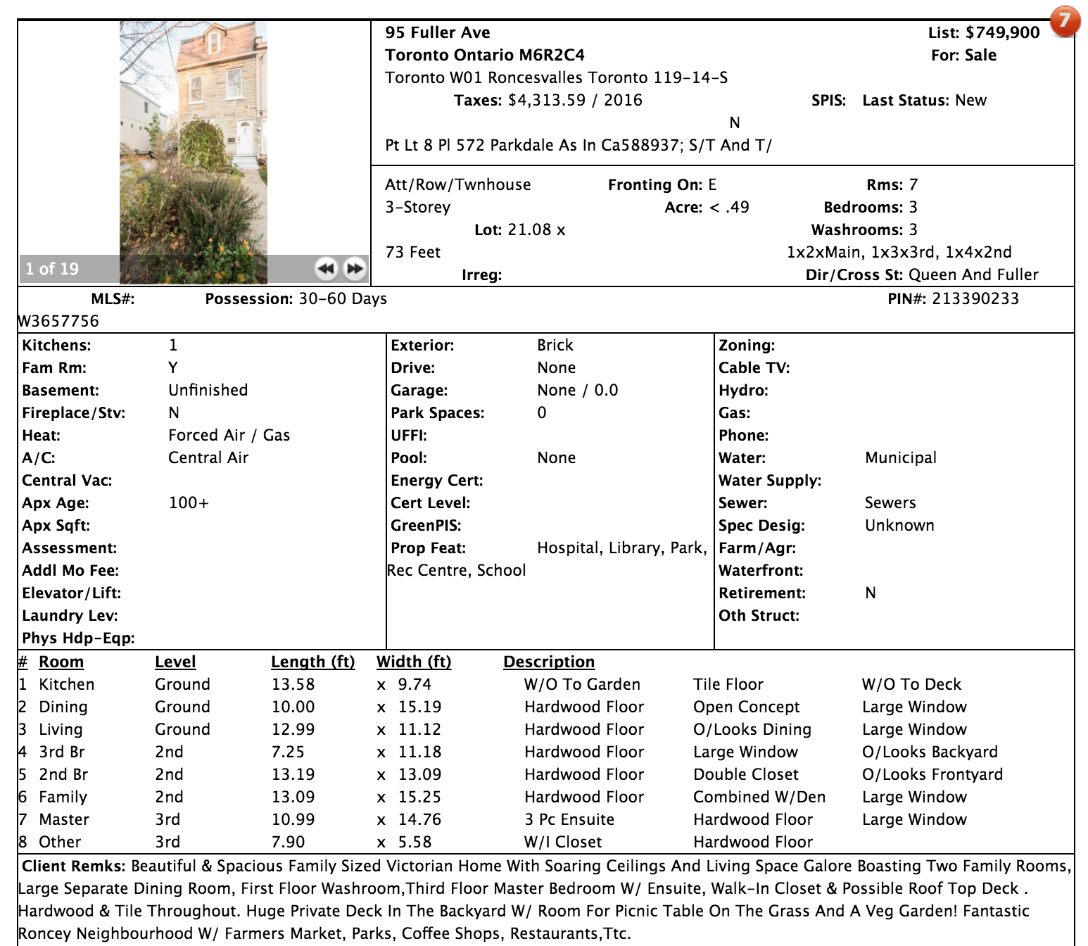
This is about the neural mechanisms by which people are doing the integration in decision making
Idea of disentangling multi-attribute choice
BACKGROUND
Notes:
A concrete example of this could be a home purchase.

Slide 10
This is about the neural mechanisms by which people are doing the integration in decision making
Idea of disentangling multi-attribute choice
BACKGROUND

Slide 11
This is about the neural mechanisms by which people are doing the integration in decision making
Idea of disentangling multi-attribute choice
BACKGROUND

Slide 12
This is about the neural mechanisms by which people are doing the integration in decision making
Idea of disentangling multi-attribute choice
BACKGROUND

Slide 13
This is about the neural mechanisms by which people are doing the integration in decision making
Idea of disentangling multi-attribute choice
BACKGROUND

Slide 14
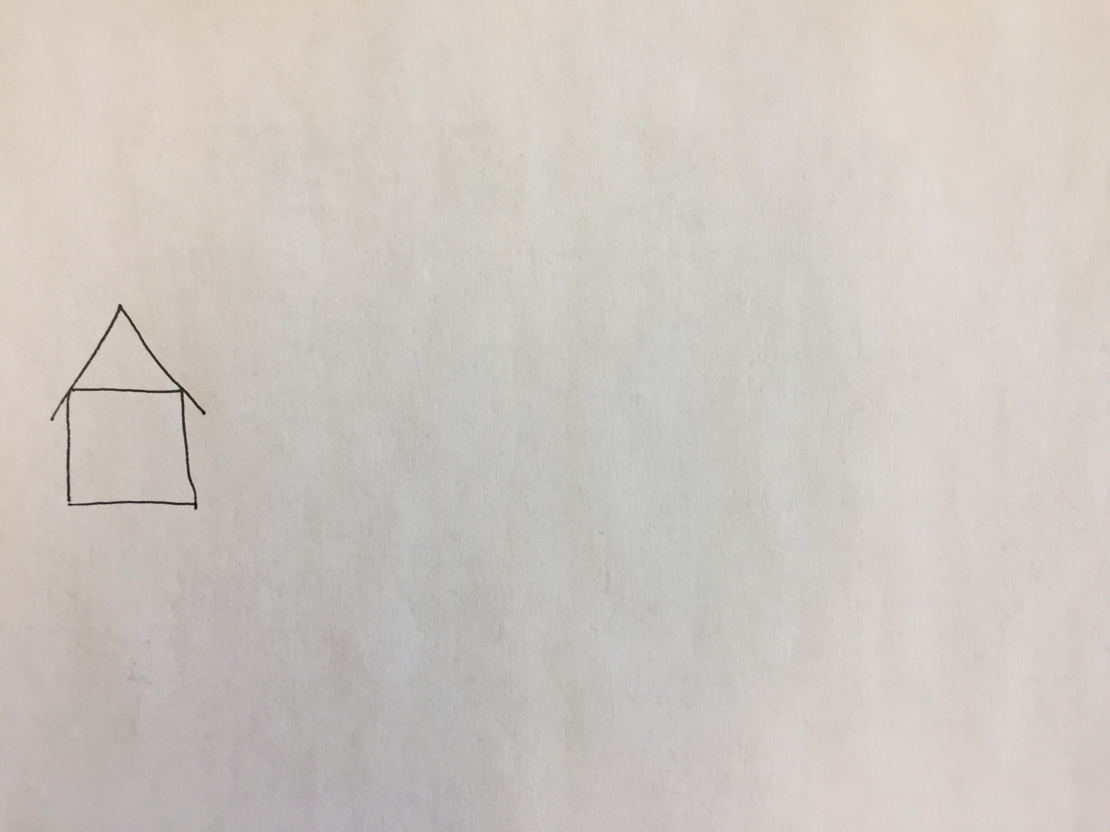
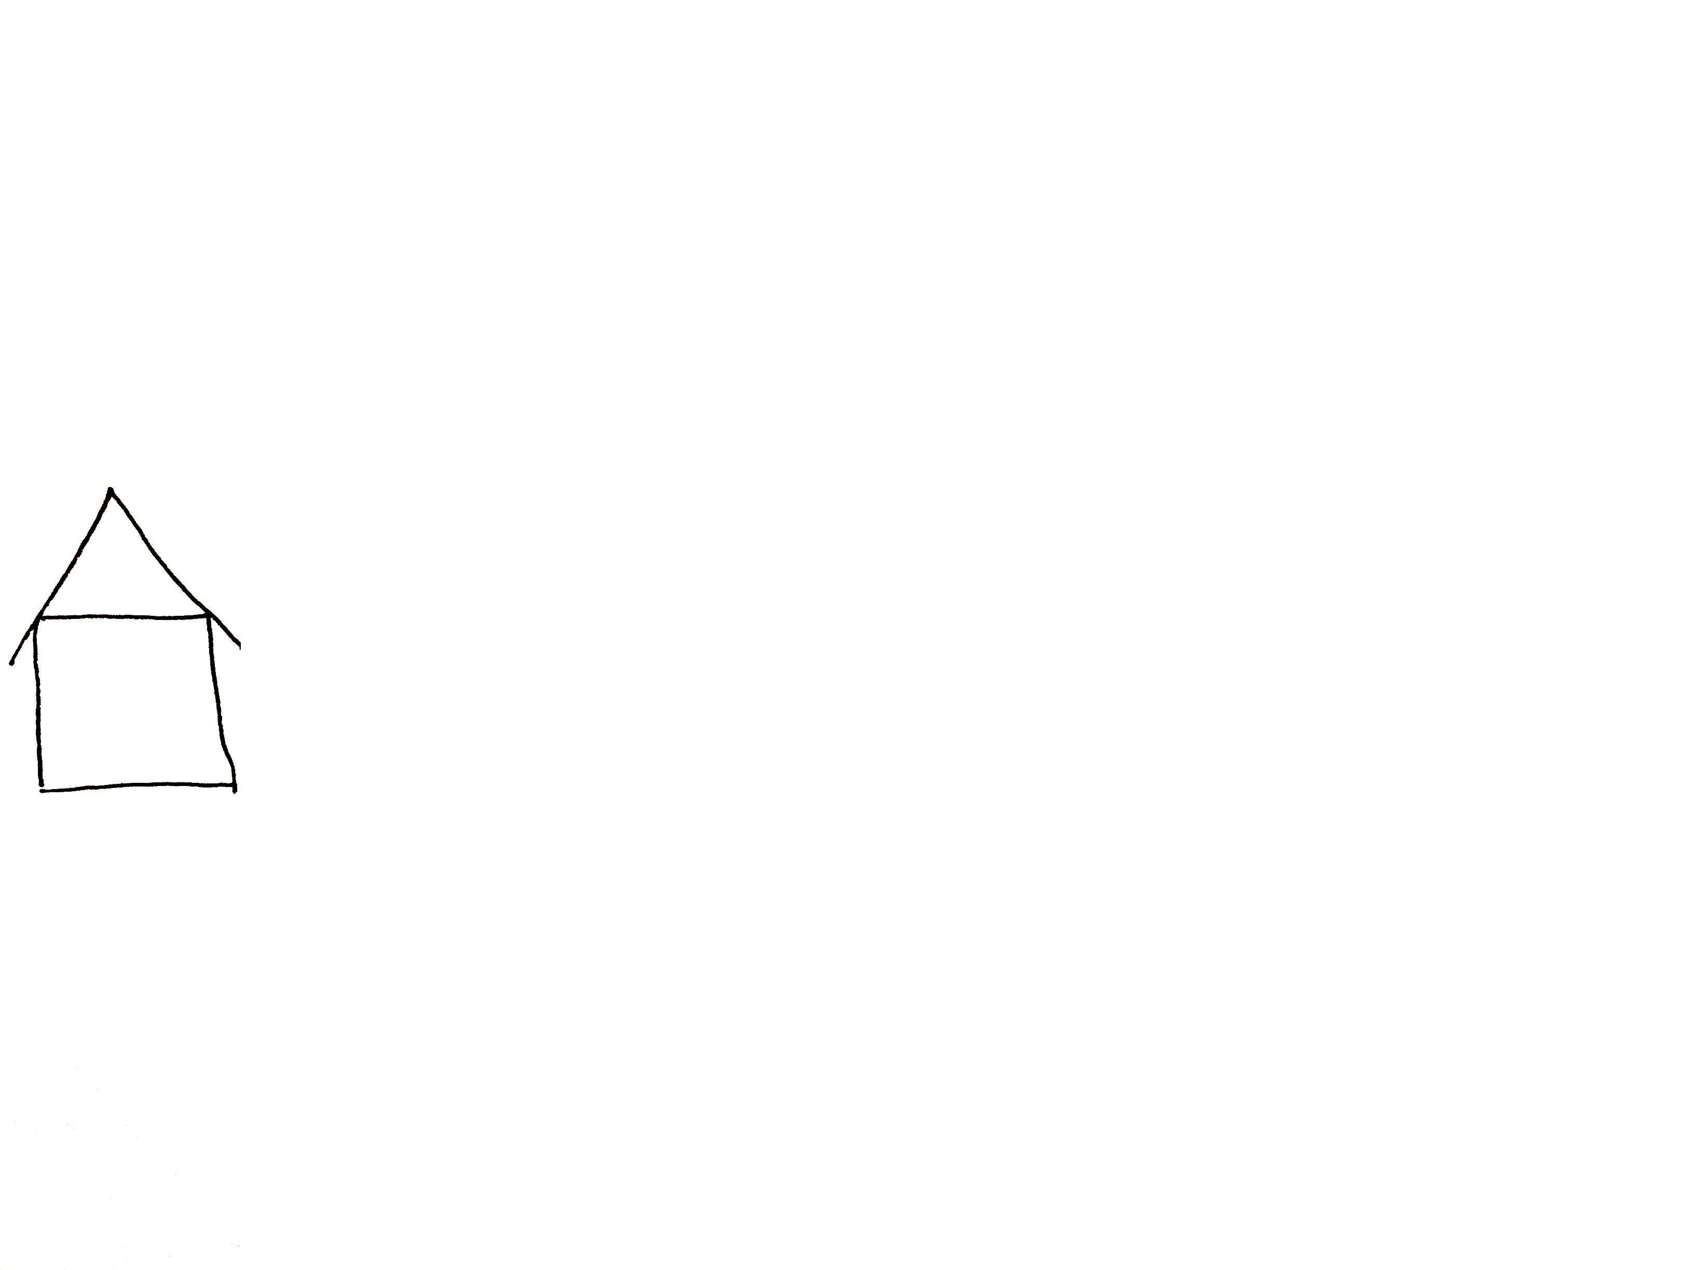
BACKGROUND
Notes:
So lets simplify what is happening to help unpack this concept of multi-attribute choice.

Slide 15
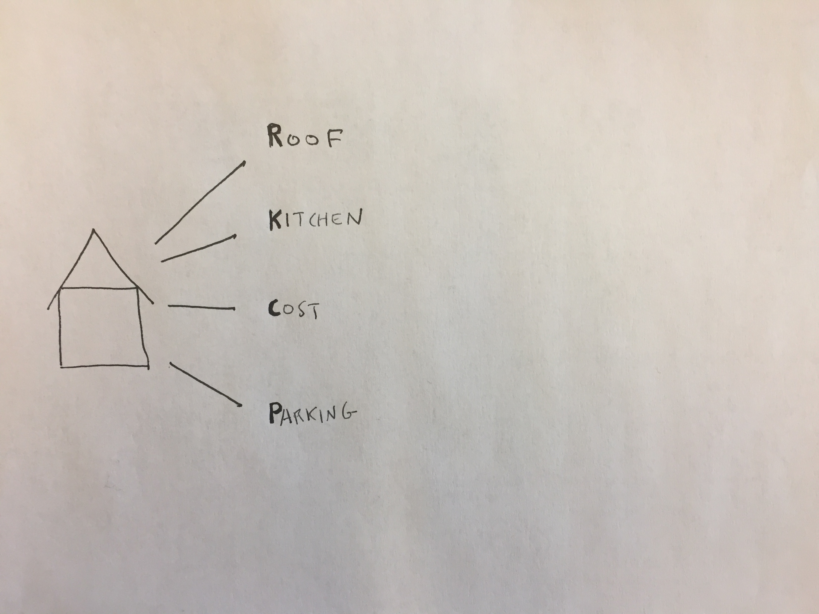
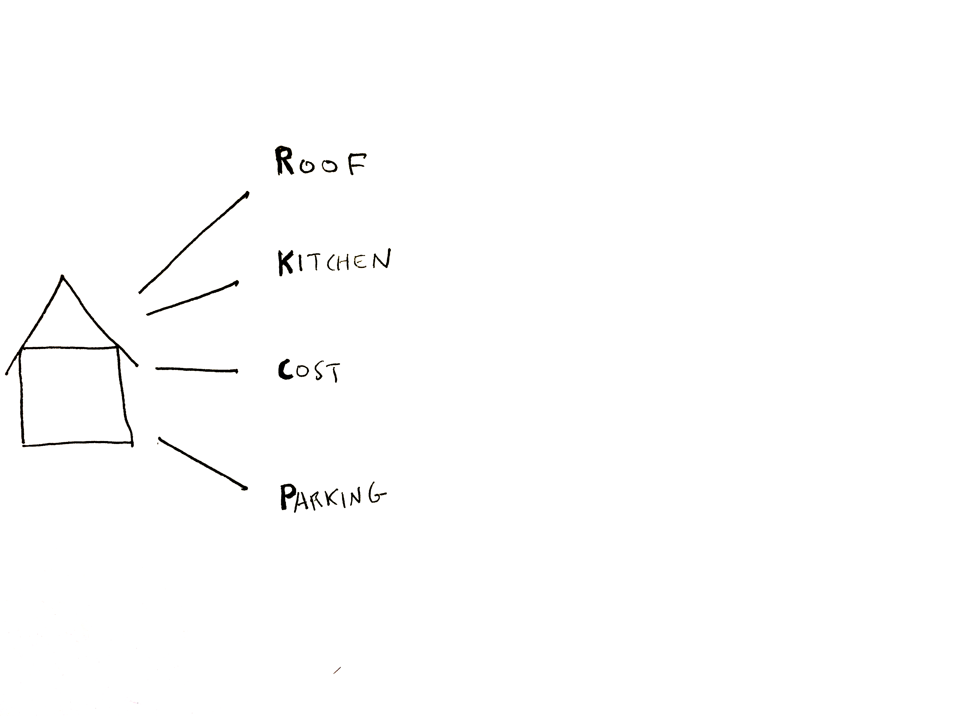
BACKGROUND
Notes:
Lets reduce the number of attributes to 4.

Slide 16
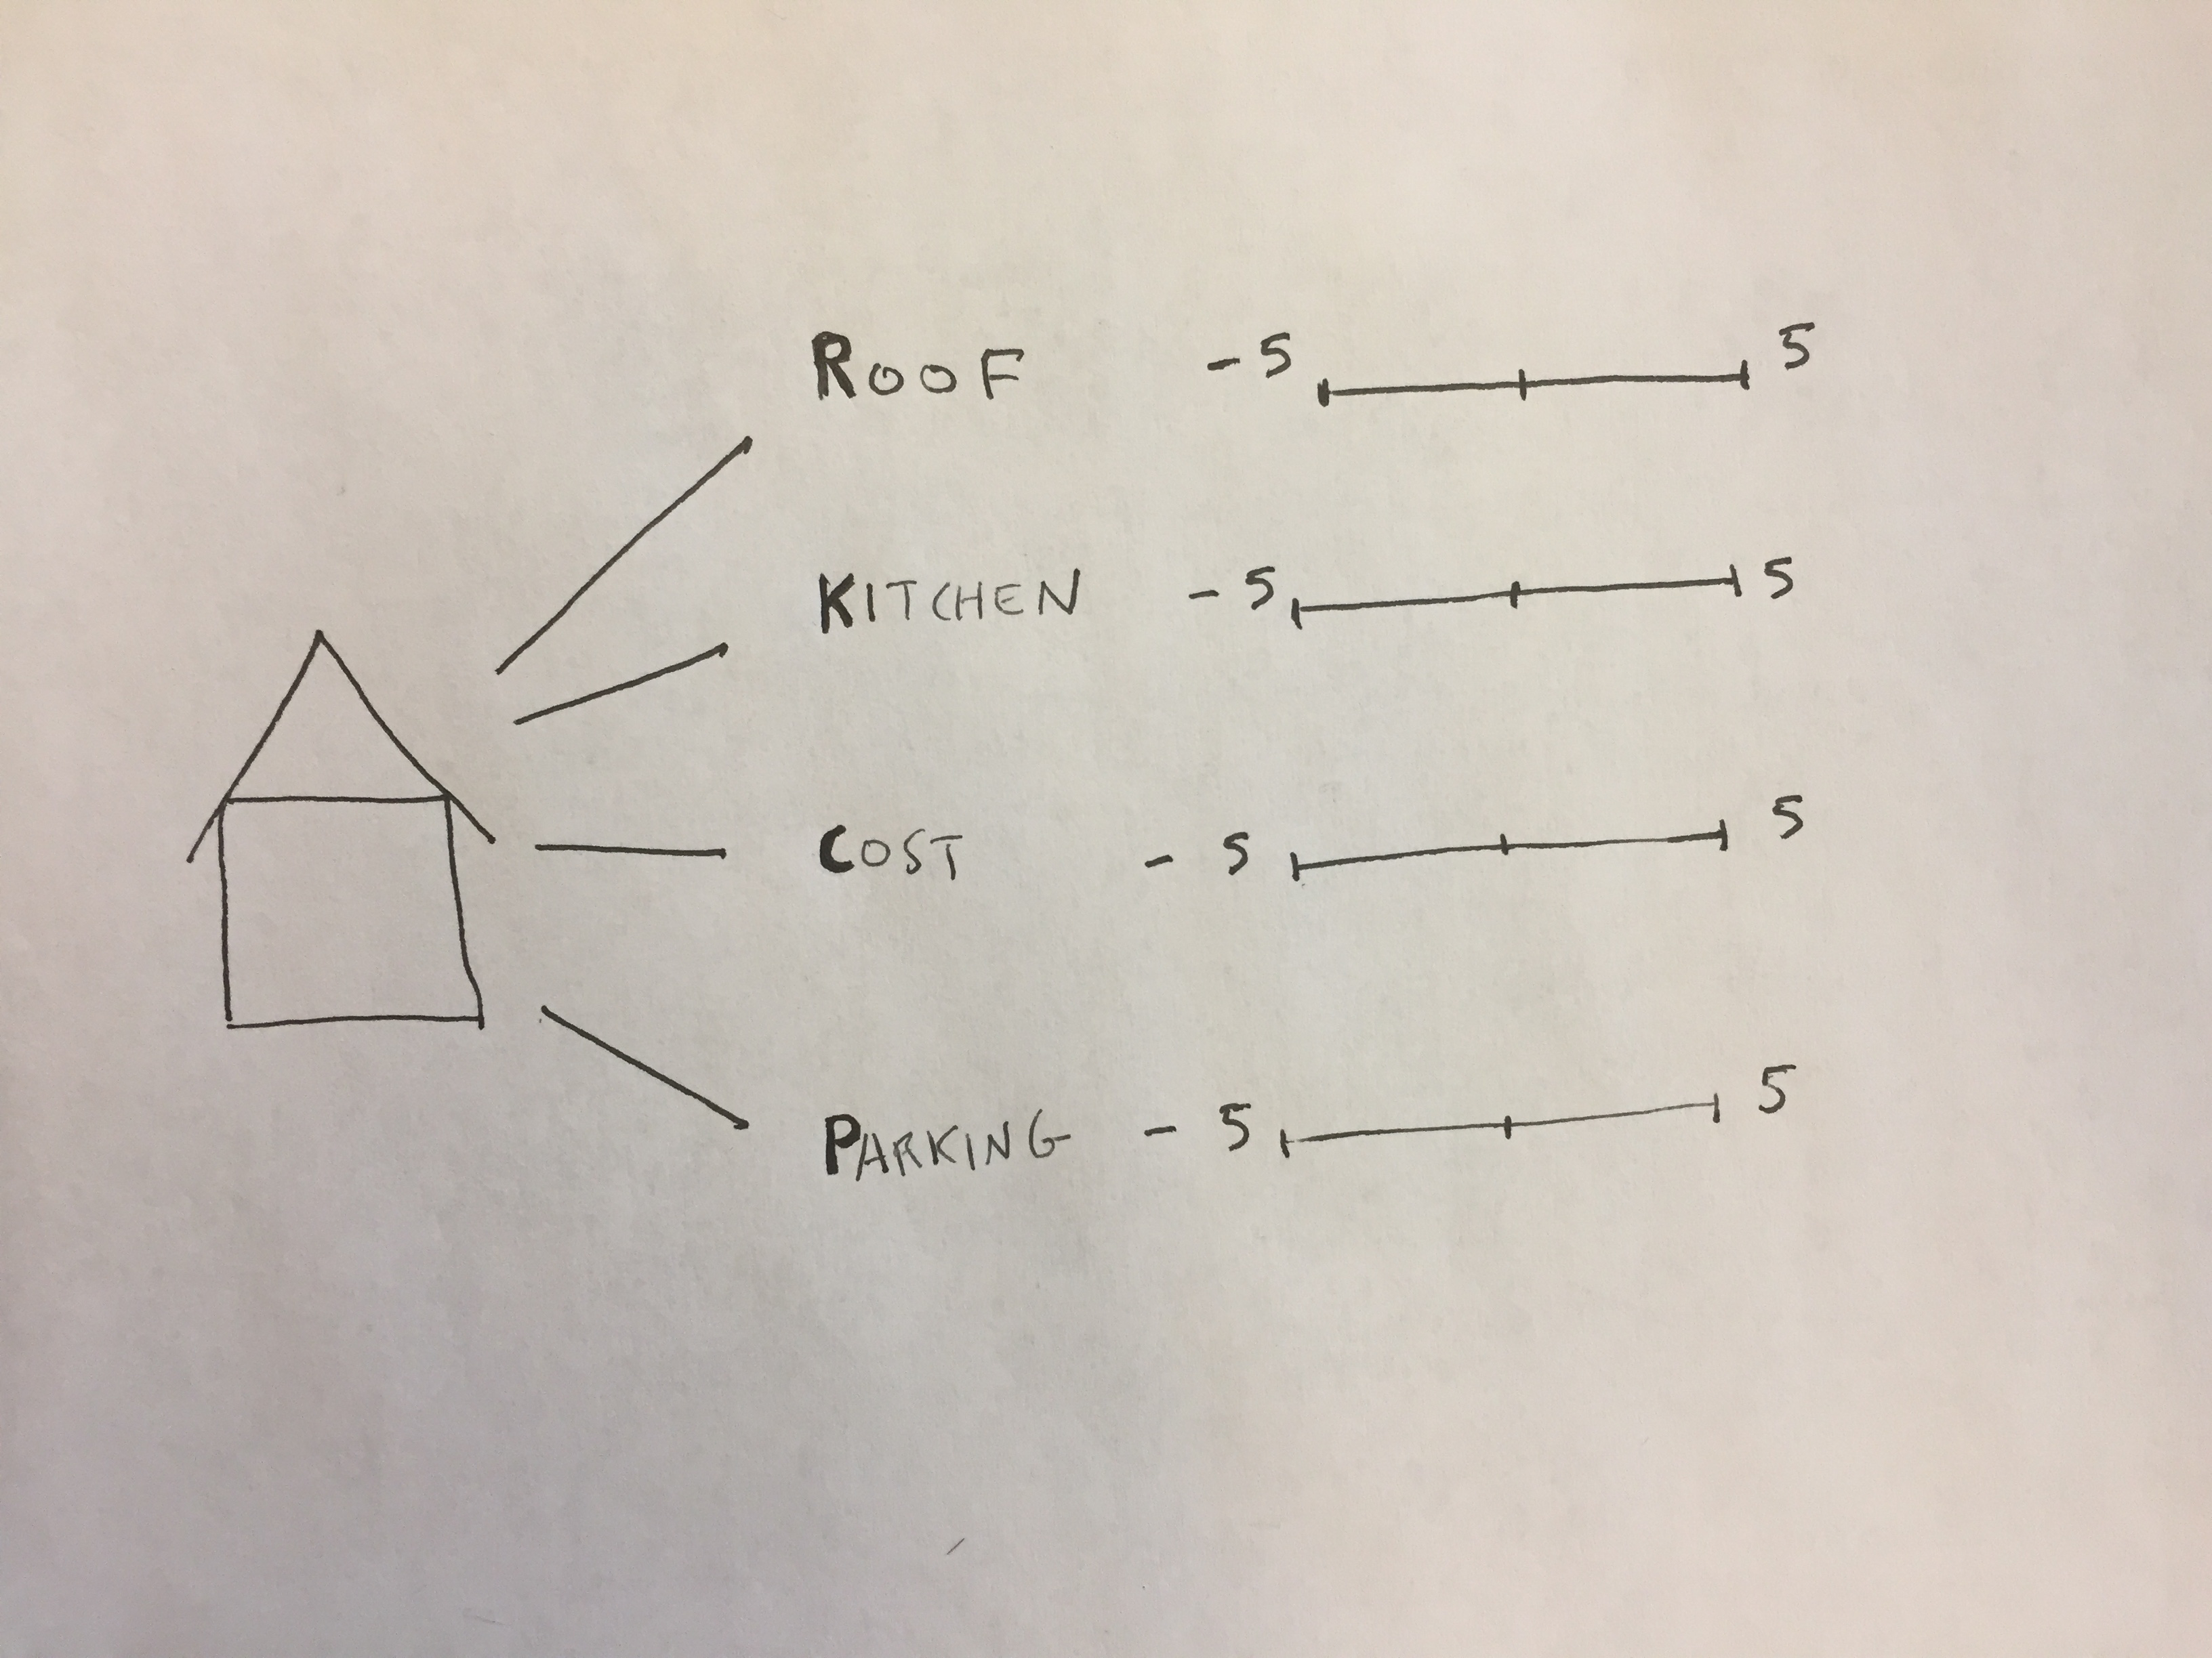
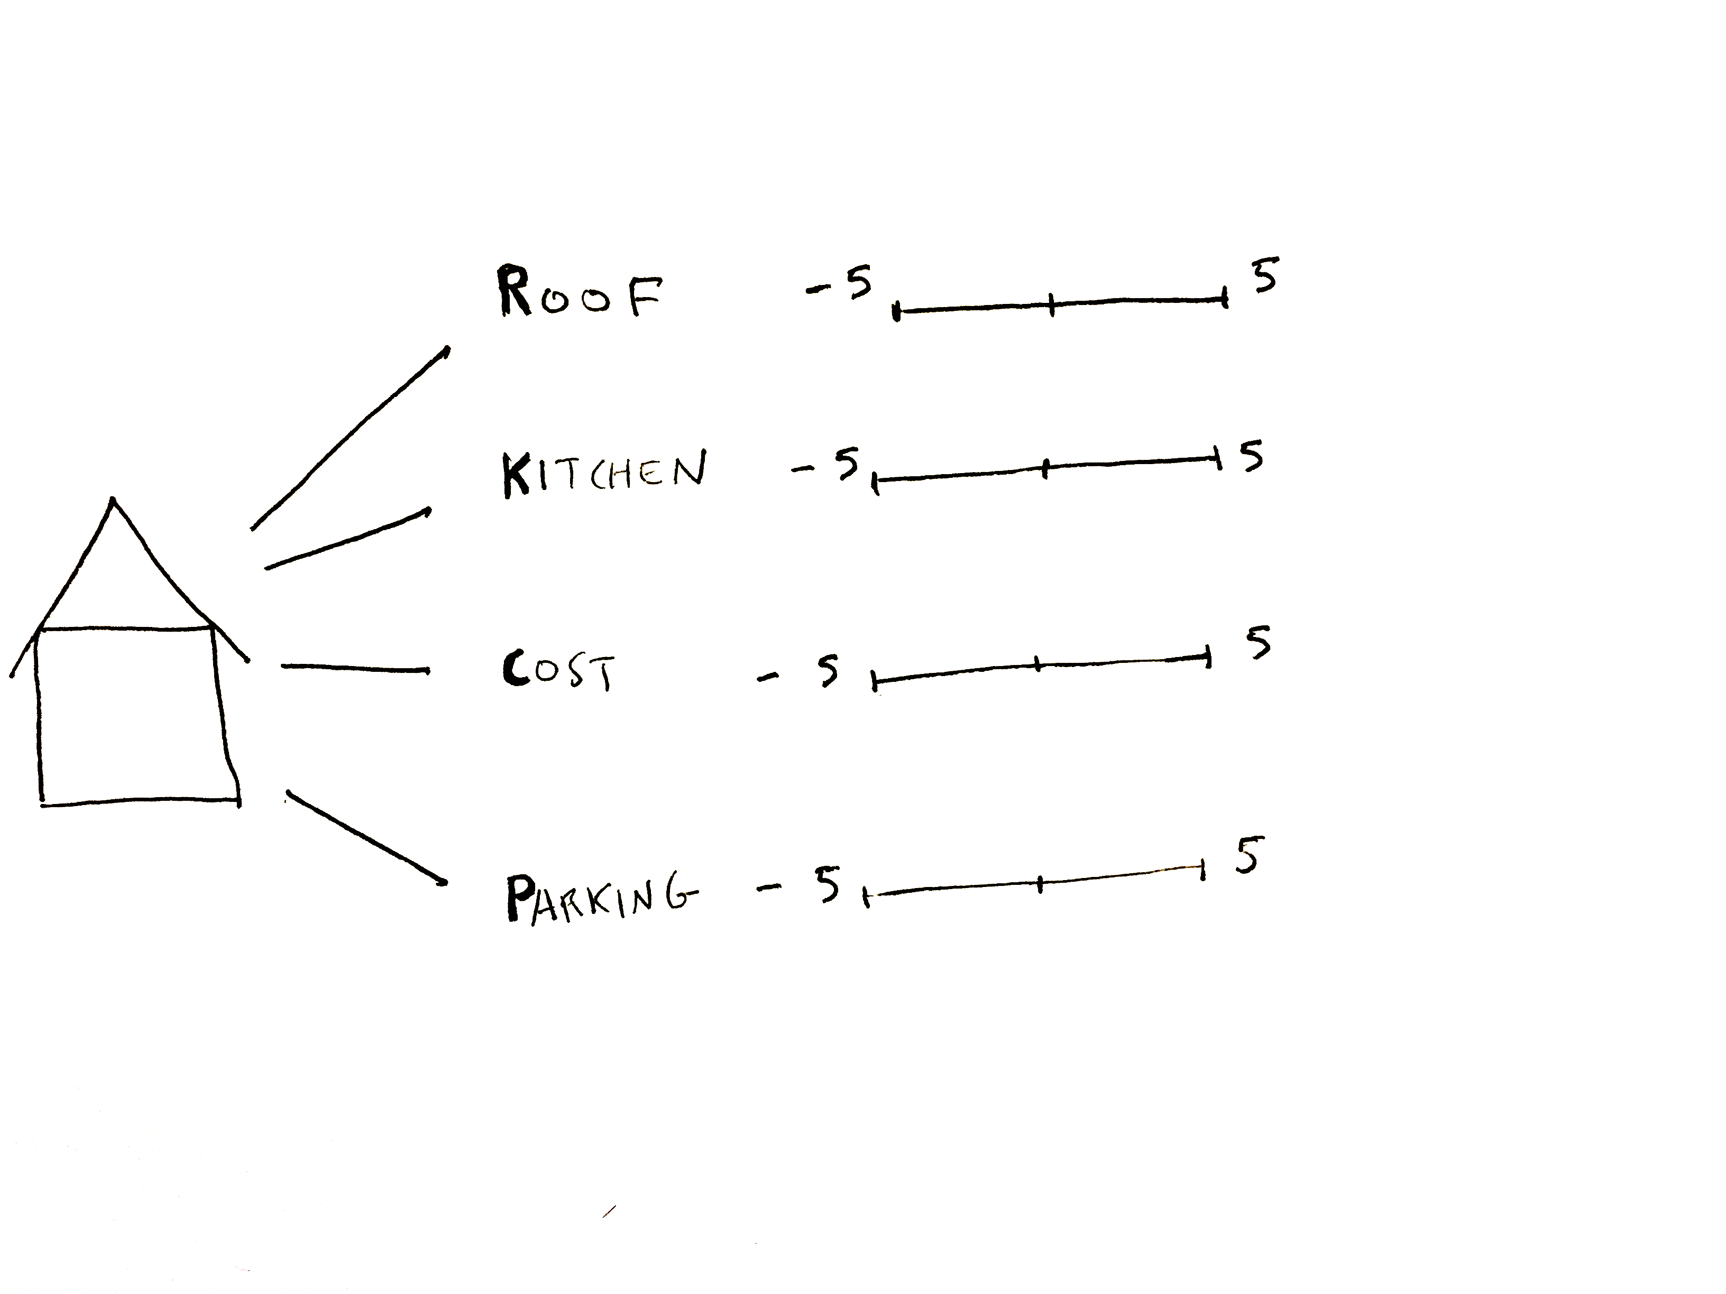
BACKGROUND
Notes:
When we think of these attributes we can assign them a value.

Slide 17
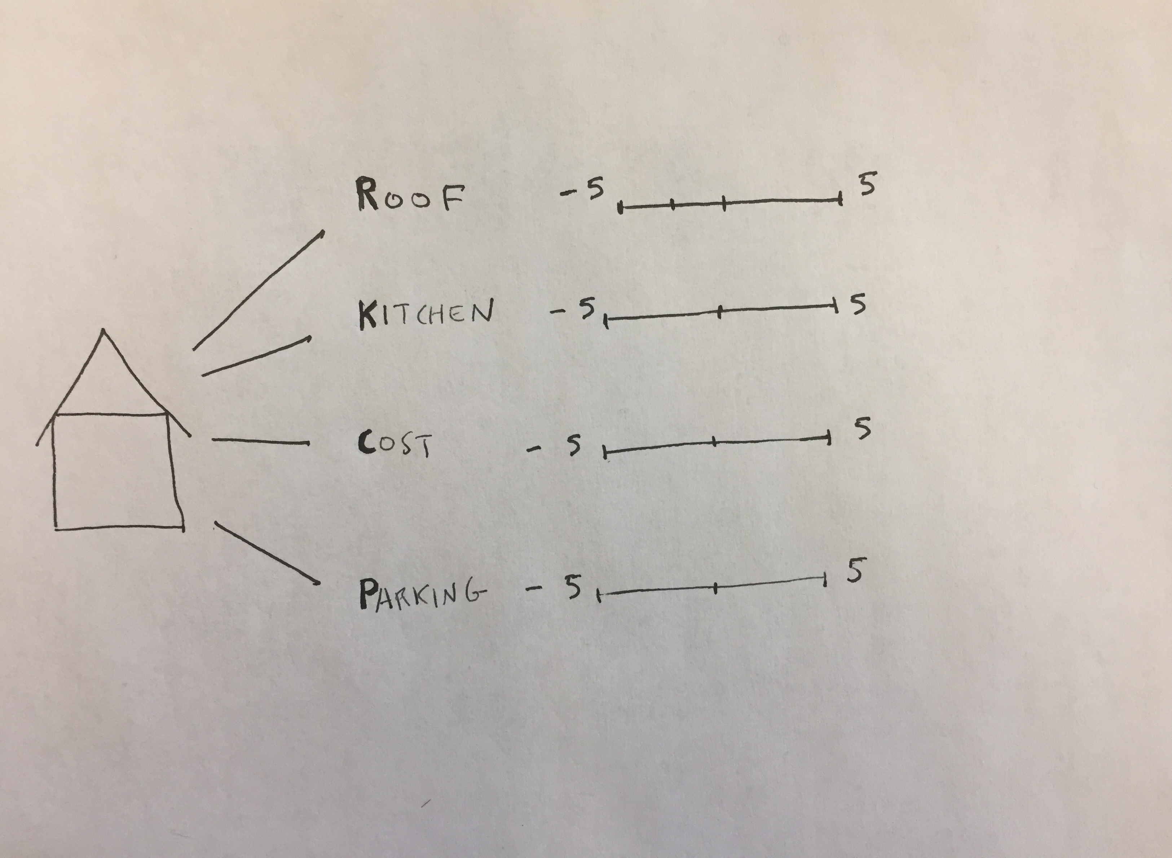
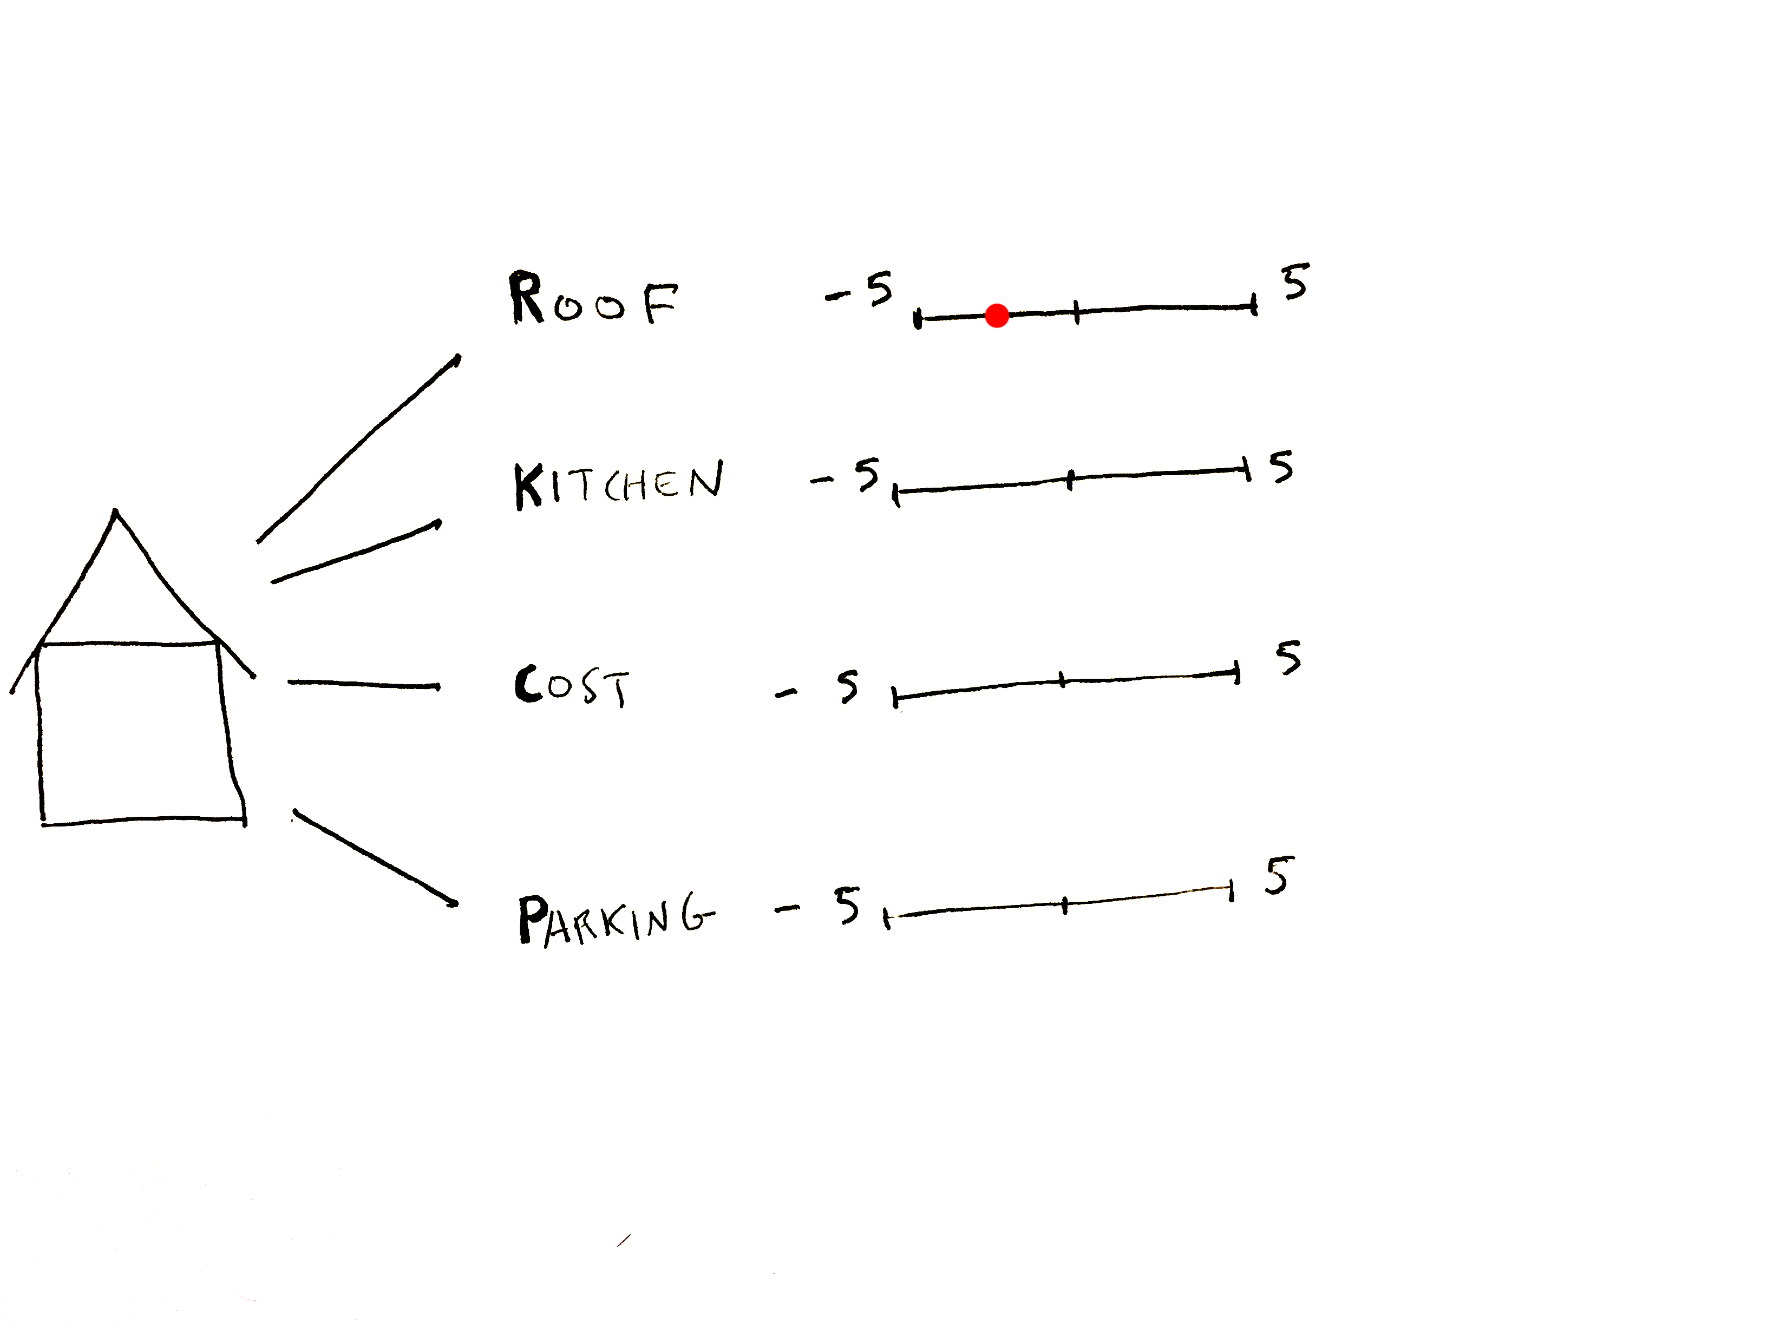
BACKGROUND
Notes:
Say for example the roof is in pretty bad condition – but it could be worse. We might give it a -2.5.

Slide 18
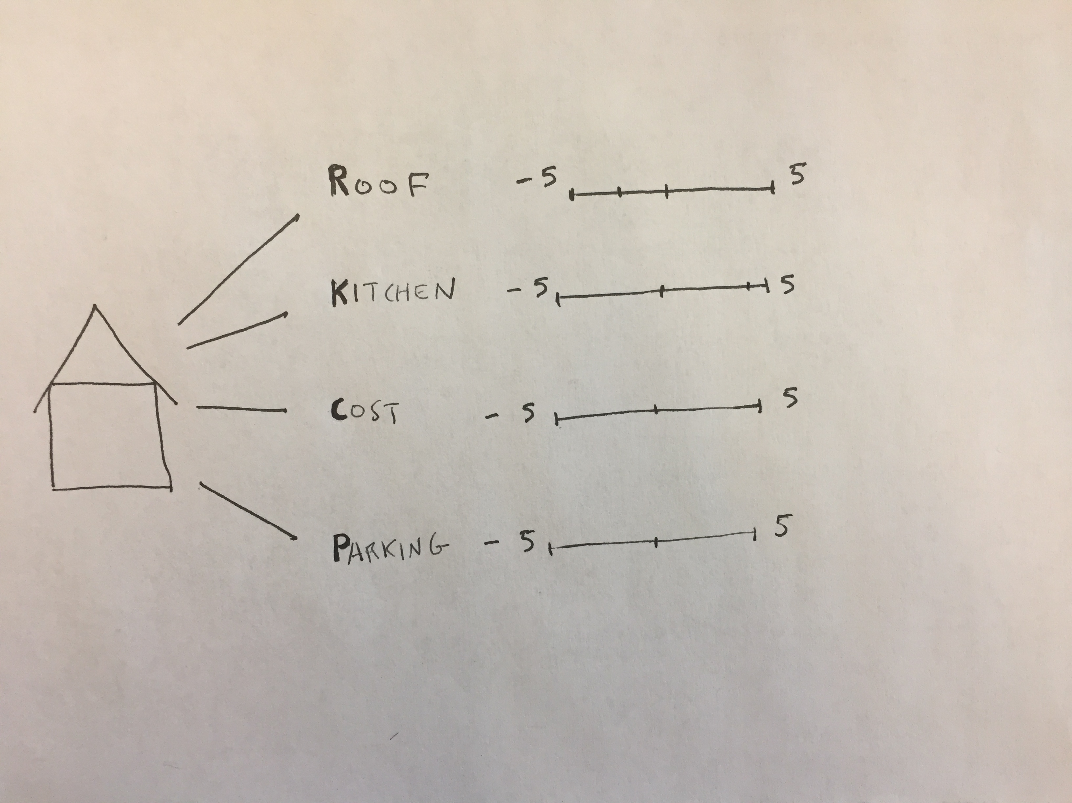
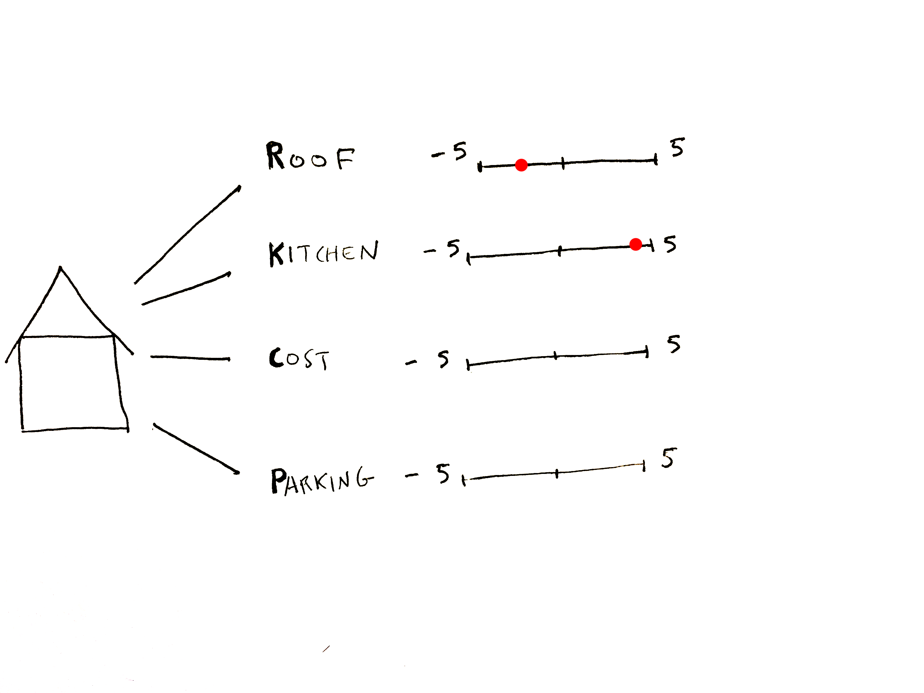
BACKGROUND
Notes:
The kitchen is great. Viking range, they’re leaving their All-clad pots, whatever…

Slide 19
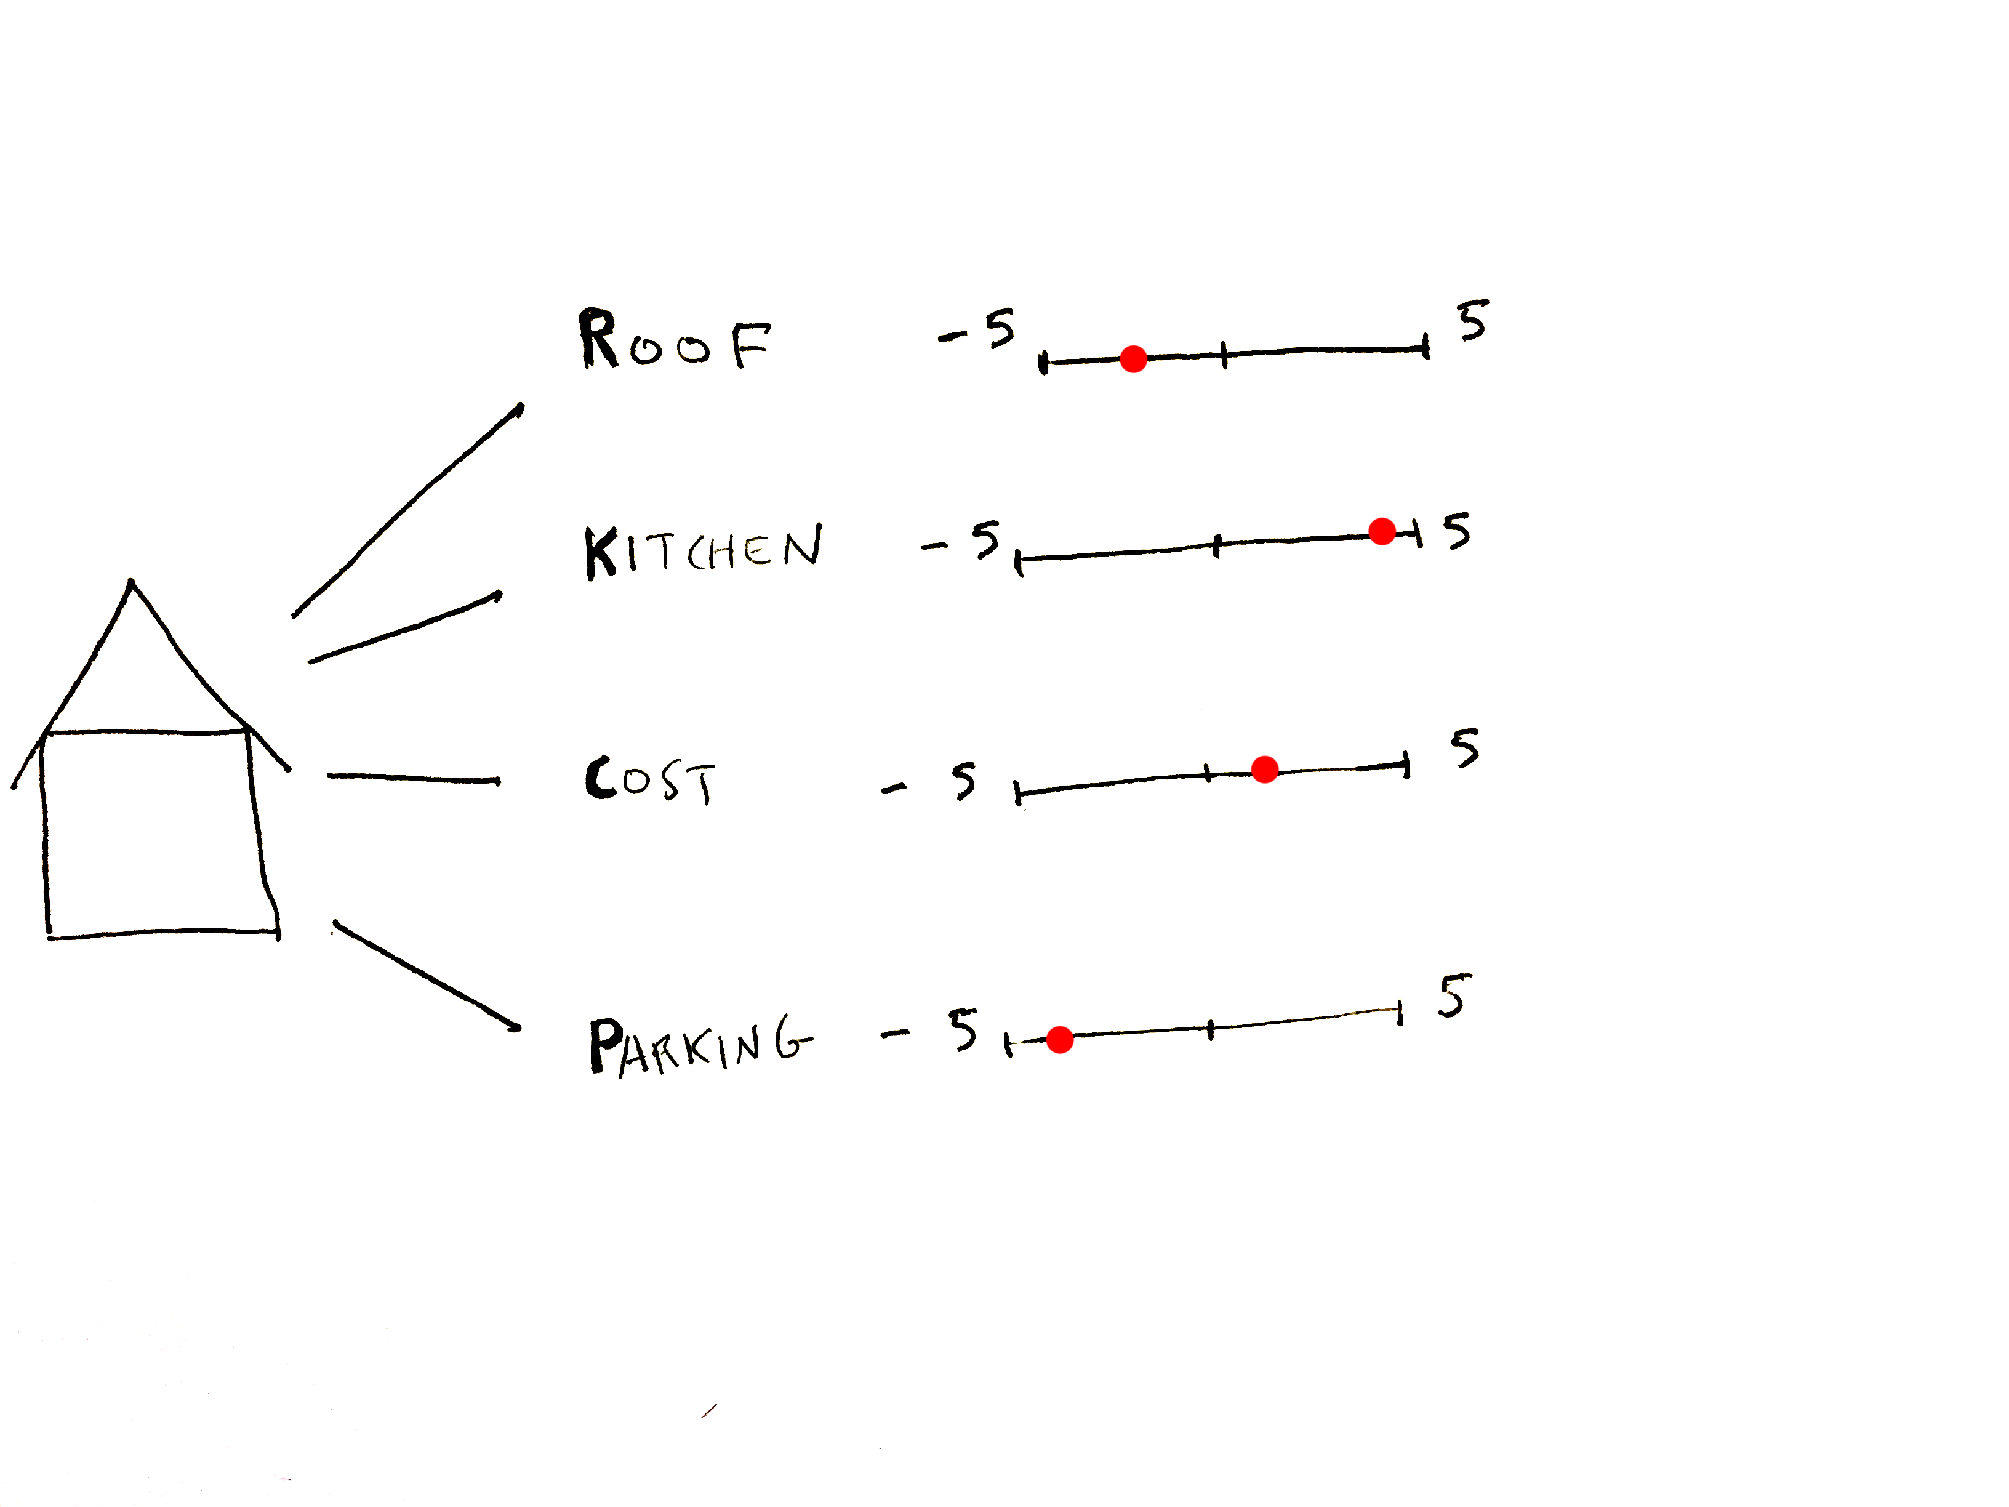
BACKGROUND
Notes:
Cost is decent and the parking is terrible.
So these are the values of the attributes we assign.

Slide 20
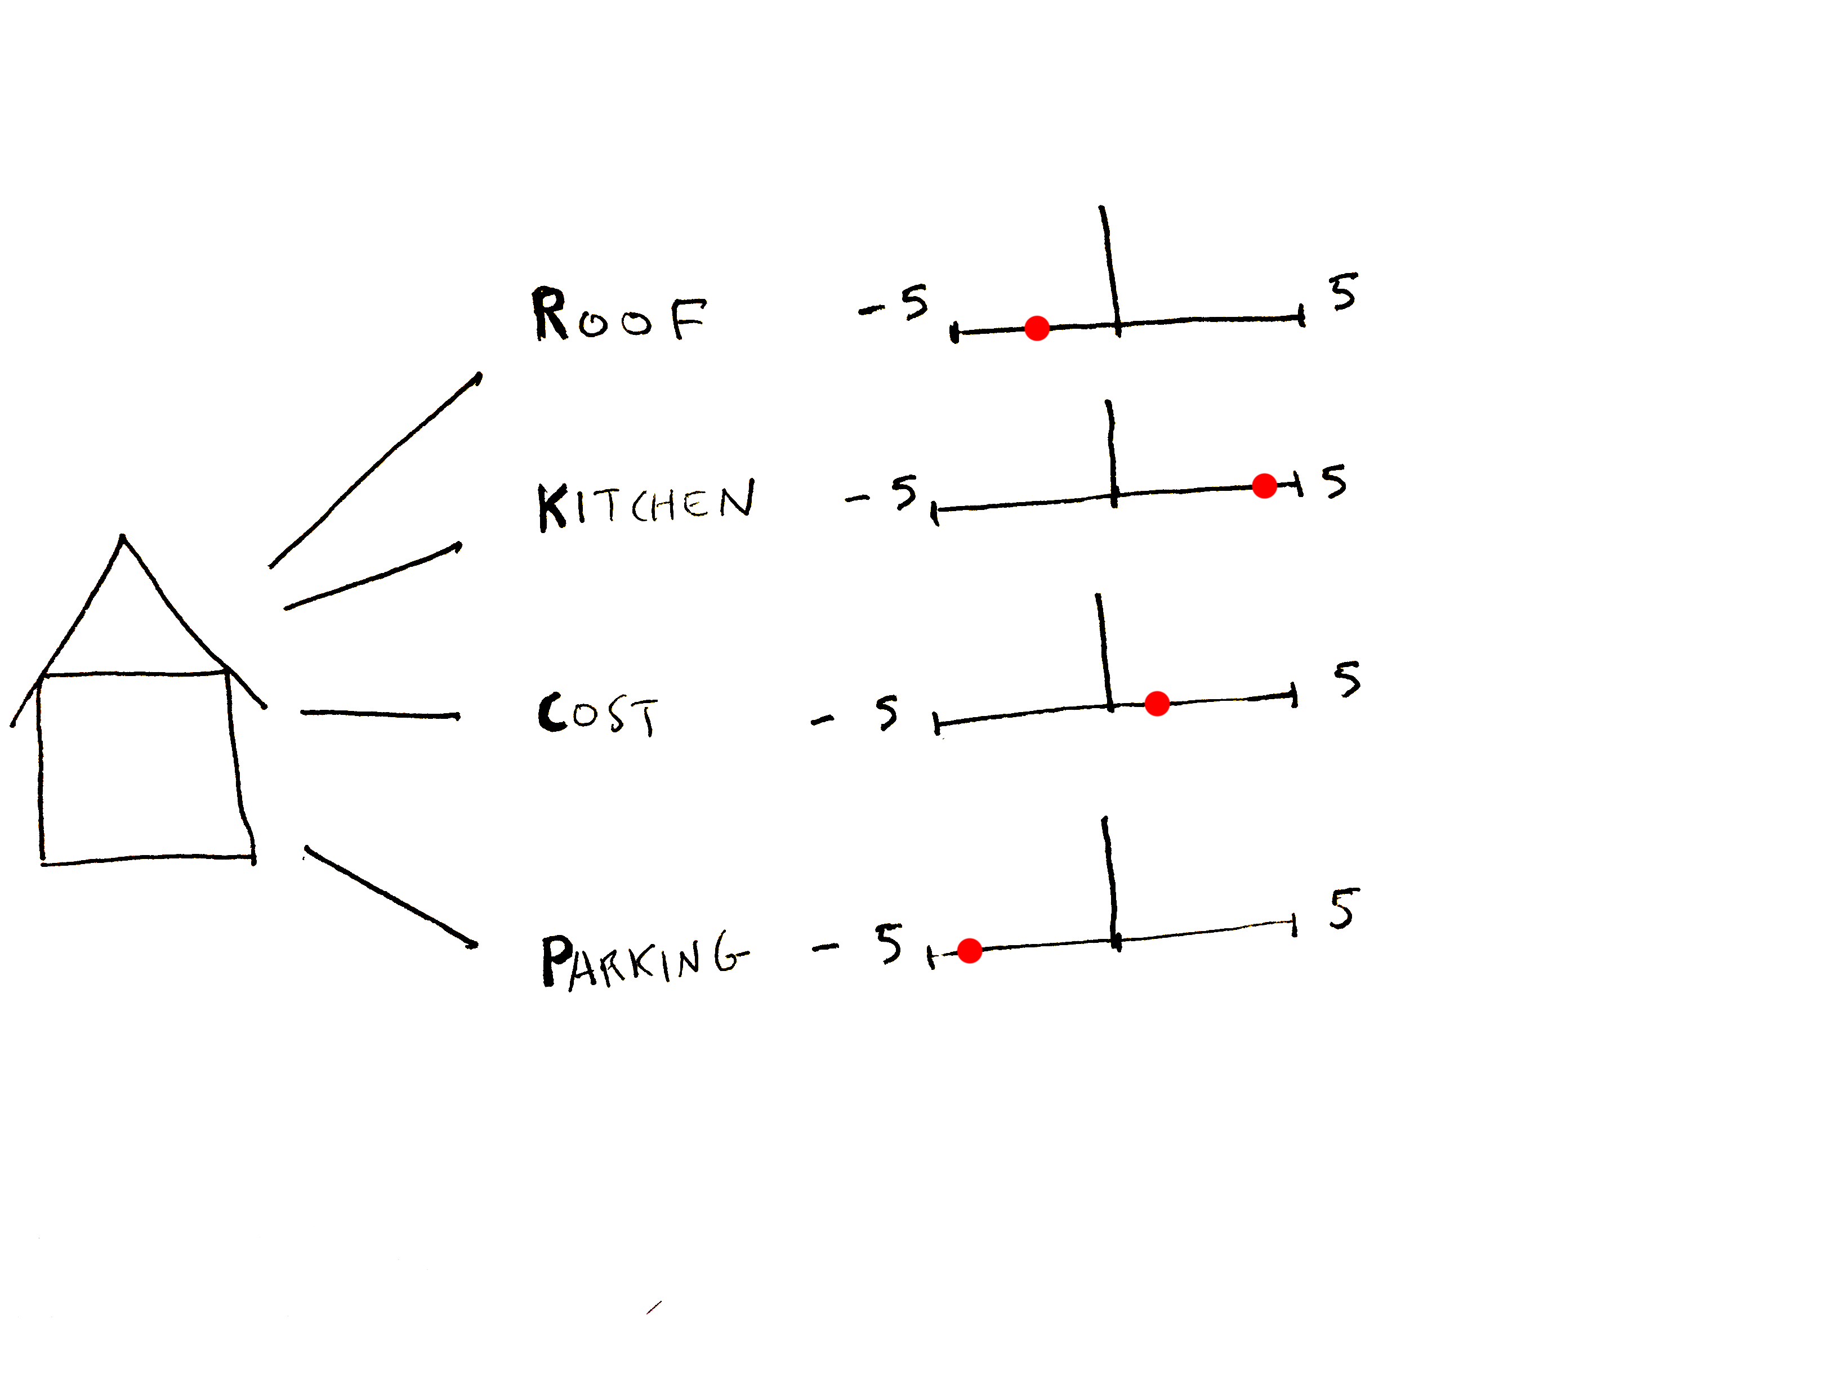
BACKGROUND
Notes:
But there is a second axis involved which is the weighting of each attribute. How much do we care about it?

Slide 21

BACKGROUND
Notes:
Maybe our uncle is a contractor so the roof isn’t that big of an issue.

Slide 22

BACKGROUND
Notes:
But the kitchen is really important because you love to cook and entertain.
The cost is also important and since you don’t have a car you really don’t care about parking.

Slide 23

BACKGROUND
Notes:
We can visualize this value/weight combination as an “area” that is associated with each attribute

Slide 24
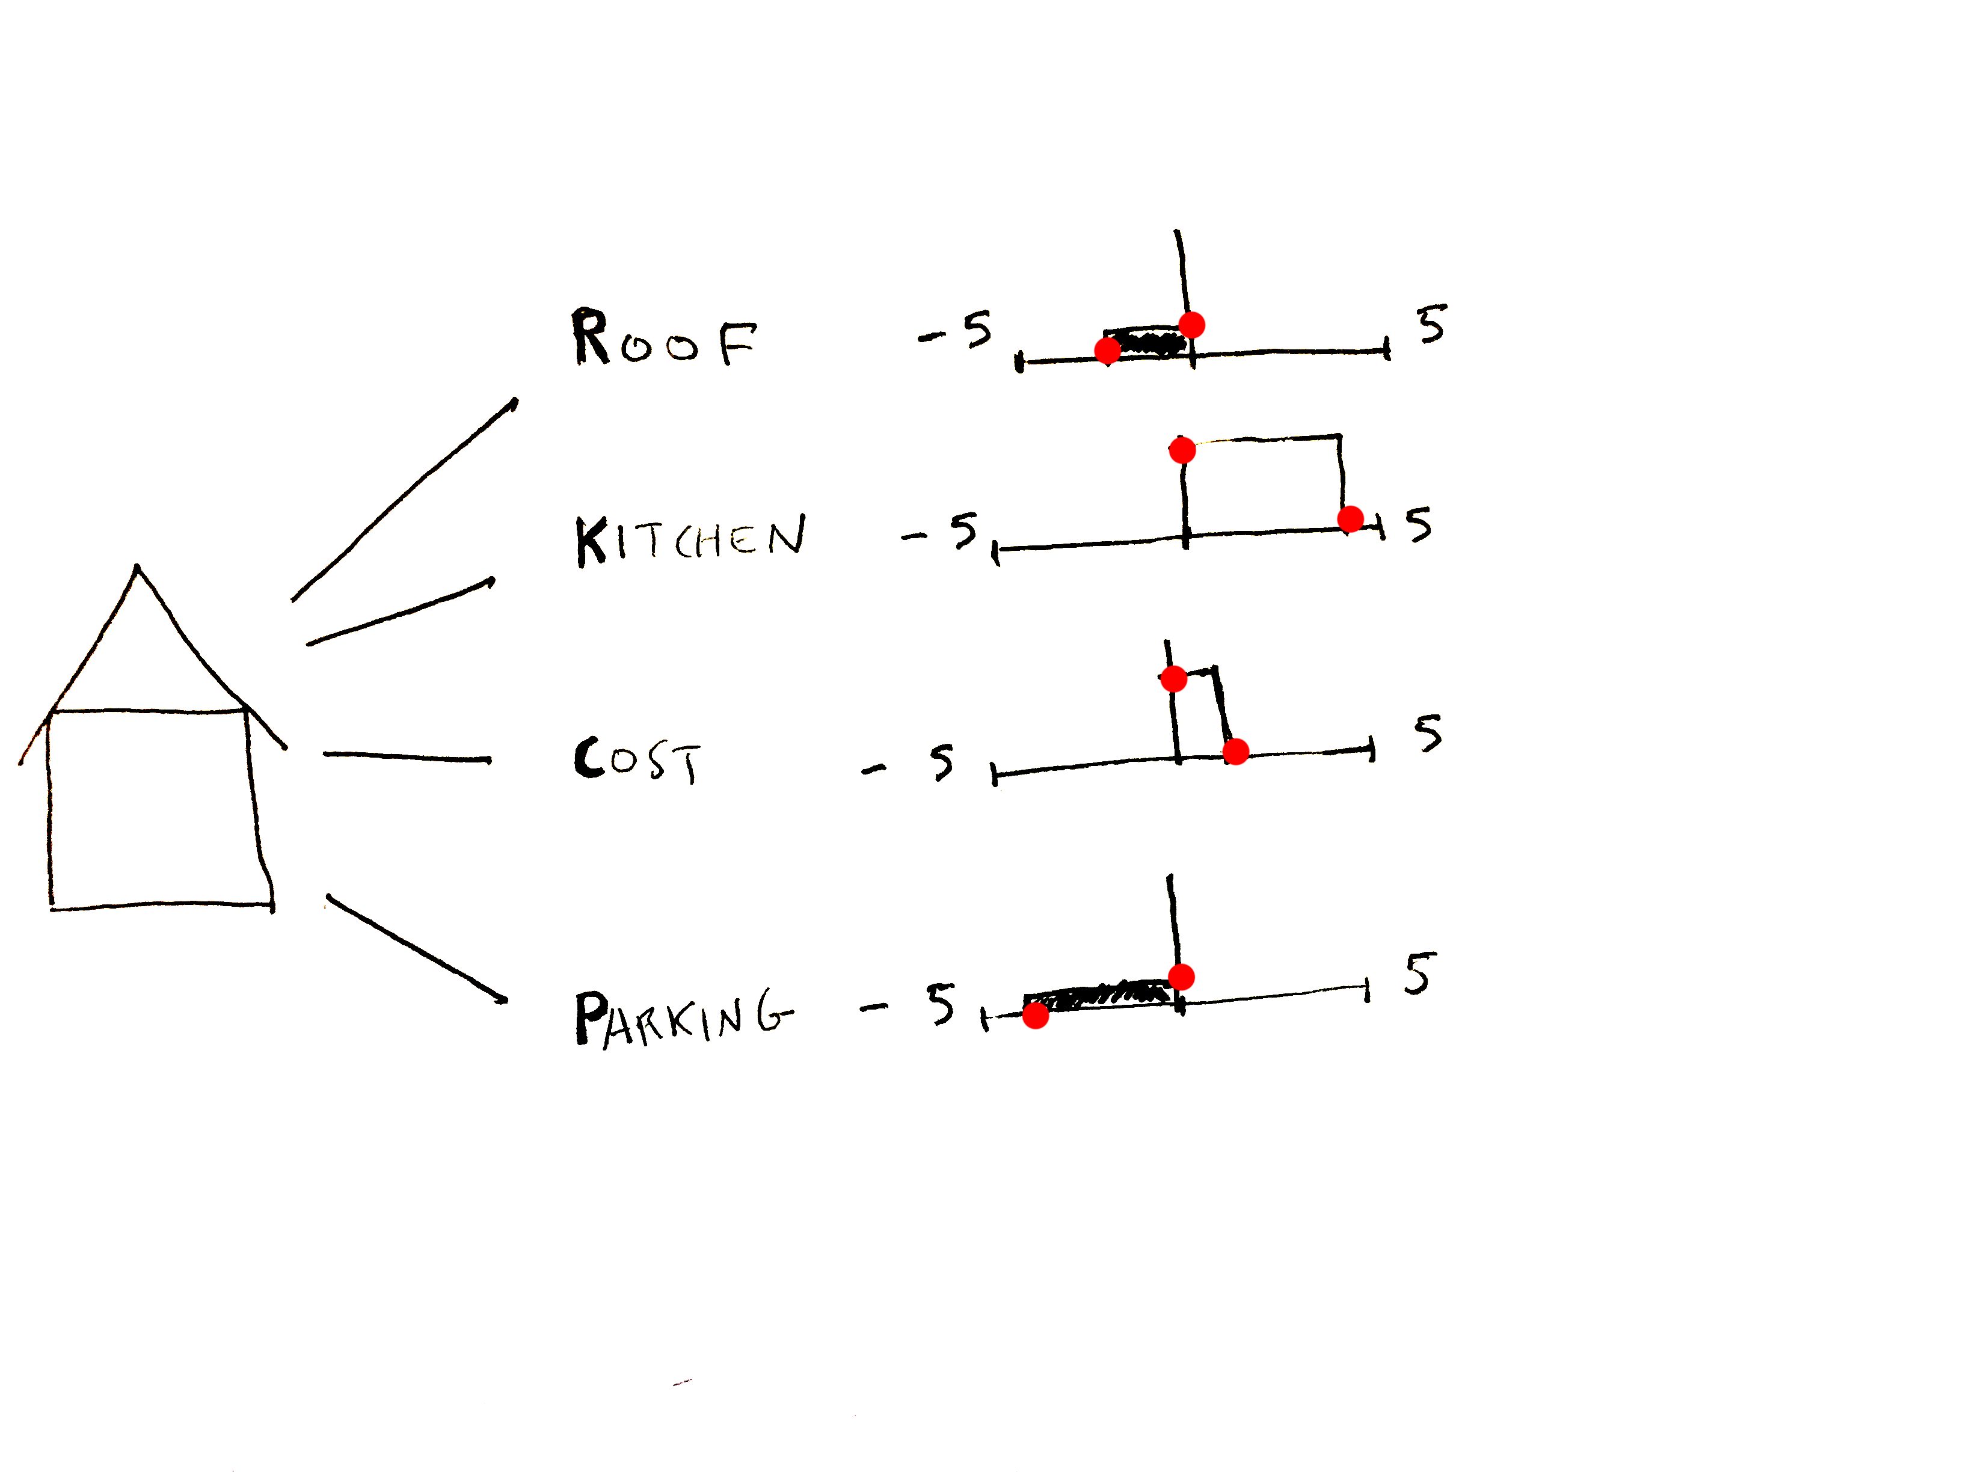
BACKGROUND
Notes:
We can visualize this value/weight combination as an “area” that is associated with each attribute

Slide 25
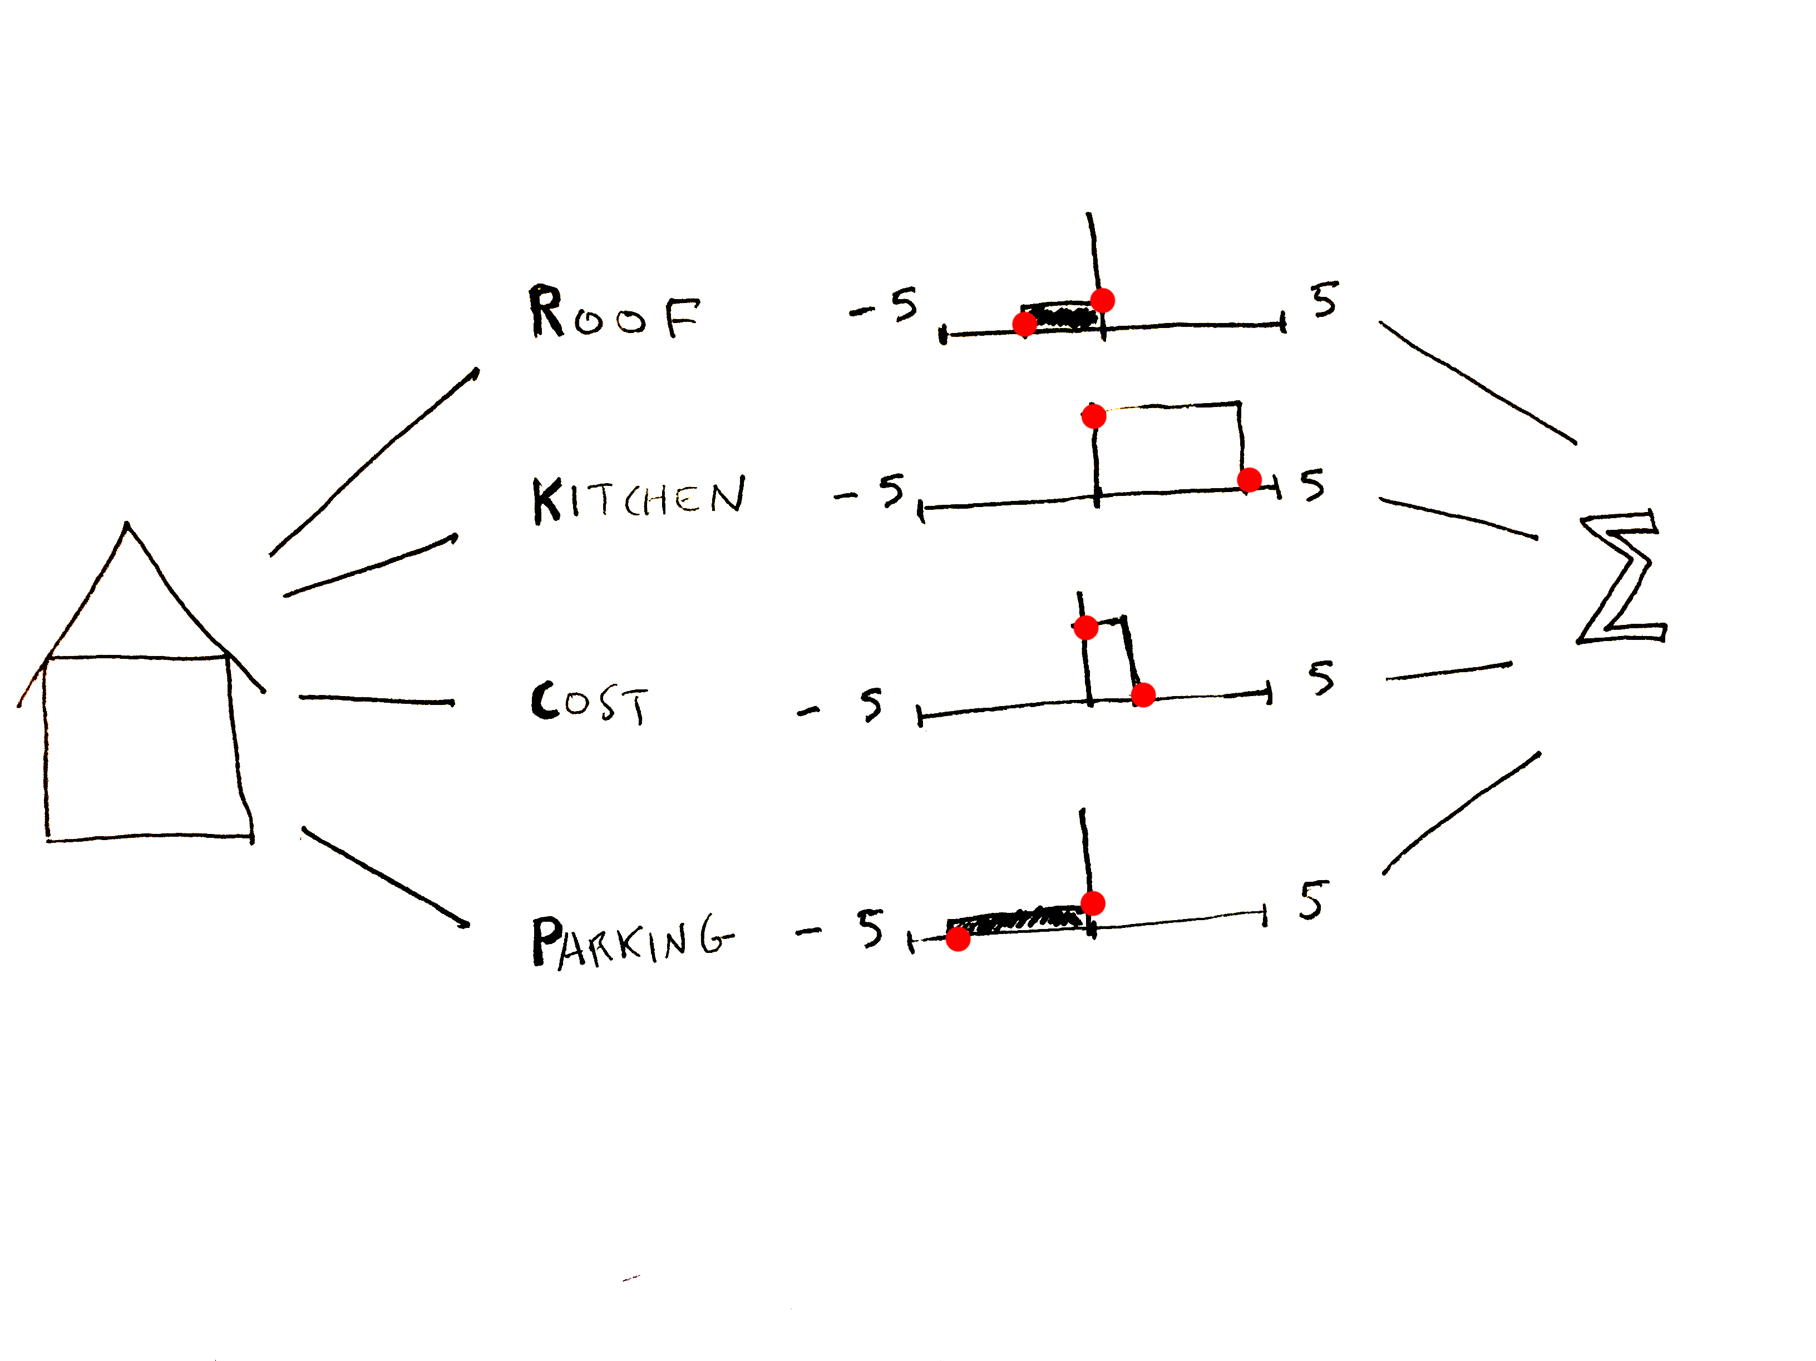
BACKGROUND
Notes:
And if we sum the areas – where the black areas are subtracted – we have a total VALUE for the house.

Slide 26
Value = w₁*ValAttribute₁ + w₂*ValAttribute₂ + ...
Bettman et al., 1998
BACKGROUND
Notes:
Weighted sum of attributes equation:
w_{i} represents the weight of a particular attribute: how important to you is this?
Attribute value is a measure of how positively or negatively you view this particular version
Keeney and Raiffa’s (1975) expected utility theory
Multi-attribute utility theory

Slide 27
Value = w₁*ValAttribute₁ + w₂*ValAttribute₂ + ...
BACKGROUND
Notes:
Weighted sum of attributes equation:
w_{i} represents the weight of a particular attribute: how important to you is this?
Attribute value is a measure of how positively or negatively you view this particular version
Keeney and Raiffa’s (1975) expected utility theory
Multi-attribute utility theory

Slide 28
Value = w₁*ValAttribute₁ + w₂*ValAttribute₂ + ...
BACKGROUND
Notes:
Weighted sum of attributes equation:
w_{i} represents the weight of a particular attribute: how important to you is this?
Attribute value is a measure of how positively or negatively you view this particular version
Keeney and Raiffa’s (1975) expected utility theory
Multi-attribute utility theory

Slide 29
Value = w₁*ValAttribute₁ + w₂*ValAttribute₂ + ...
BACKGROUND
Notes:
The Value component of this equation refers to the summation of all of the component attributes’ weighted values.
This “end result” is fairly well understood both in terms of where and how.

Slide 30
Value = w₁*ValAttribute₁ + w₂*ValAttribute₂ + ...
Kable and Glimcher, 2007
Hare et al., 2009
Basten et al., 2007
BACKGROUND
Notes:
In terms of WHERE this value summation is taking place, Based on the literature it seems that the vmPFC is a strong candidate as it has been shown to play an important role in decision making and value integration.
“Goal-directed decisions have their basis in a common value signal encoded in ventromedial prefrontal cortex (vmPFC)”
“neuroimaging studies that have found a correlation between activity in this area and behavioral measures of value”
“exercising self-control involves the modulation of this value signal by dorsolateral prefrontal cortex (DLPFC)”
BUT
Activity in vmPFC was correlated with goal values regardless of the amount of self-control

Slide 31
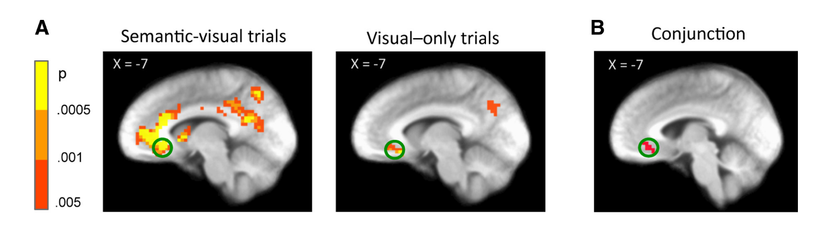
Lim et al., 2013
BACKGROUND
Notes:
Support for this in a recent study by Lim
Where Integrated value seems to show up in vmPFC
Recent work from Hutcherson found that the – DLPFC may also be involved and OVERALL
enough inconsistency re: exactly what it is doing and how, that we need more info…
“activity in ventro-medial prefrontal cortex correlates with stimulus values at the time of choice”
Along with Where for the weighted value integration we also have models that accurately capture HOW this process unfolds.
“choices are made by computing the value of the different attributes and then integrating them into an overall stimulus value signal.”
Fusiform Gyrus correlated with value of visual aesthetic
Posterior Superior Temporal Gyrus associated with processing of semantic meaning
**BOTH areas exhibited functional connectivity with vmPFC
We constructed an artificial stimulus set in which we were able to isolate and measure stimulus and attribute values. The stimuli were customized gray T-shirts with a Korean word printed prominently on them (Fig. 1D). Subjects cared about the T-shirts because at the end of the experiment they got the one shown in a randomly selected trial. The words differed in their semantic (or meaning) attributes and on their visual (or esthetic) attributes. The semantic attributes ranged from very negative words like “rape” to very positive ones like “hope” (Table 1). The visual attributes were varied by changing colors and font types. The word stimuli were constructed by randomly combining both attributes. A series of tasks allowed us to obtain independent behavioral measures of the values each subject assigned to each attribute, as well as the integrated stimulus value they assigned to each T-shirt (i.e., based on both its visual and semantic attributes).

Slide 32
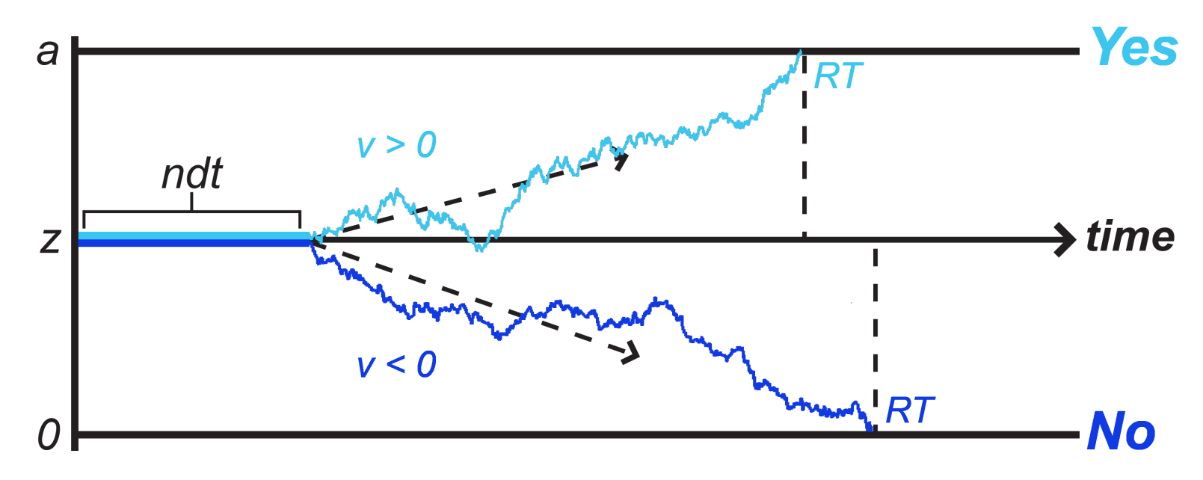
Threshold: Yes
Cupcake
Threshold: No
Apple
Hutcherson et al., 2015
Sullivan et al., 2015
Ratcliff & McKoon, 2008
Tajima et al., 2016
BACKGROUND
Notes:
HOW: In terms of modeling the decision process
Work done by Cendri Hutcherson, among others, suggests that Drift Diffusion modeling can capture this choice integration in a predictive way.
Model fits to behavior indicated that Tusche & Hutcherson were able to capture both choices and RTs with high accuracy using a multi-attribute extension of the standard DDM (FIGURE S1).
This information is then passed to regions of the brain involved in motor and attentional processes important for action selection^{18,19}.
Computational model of choice
Drift diffusion models

Slide 33
QUESTIONS
1. Where in the brain is attribute valuation happening?
BACKGROUND
Notes:
1 & 2 are lower level questions, they allow us to get at question 3
Does weighting happen serially? Guy from conference…

Slide 34
QUESTIONS
1. Where in the brain is attribute valuation happening?
2. Where in the brain is attribute weighting happening?
BACKGROUND
Notes:
1 & 2 are lower level questions, they allow us to get at question 3
Does weighting happen serially? Guy from conference…

Slide 35
QUESTIONS
1. Where in the brain is attribute valuation happening?
2. Where in the brain is attribute weighting happening?
a. Cortical Areas
b. Ventromedial Prefrontal Cortex
c. Communication Pathways
d. ???
BACKGROUND
Notes:
1 & 2 are lower level questions, they allow us to get at question 3
Does weighting happen serially? Guy from conference…

Slide 36
QUESTIONS
1. Where in the brain is attribute valuation happening?
2. Where in the brain is attribute weighting happening?
a. Cortical Areas
b. Ventromedial Prefrontal Cortex
c. Communication Pathways
d. ???
How do we re-weight attributes?
BACKGROUND
Notes:
1 & 2 are lower level questions,
they allow us to get at question 3
SELF CONTROL – simple example is dieting
Does weighting happen serially? Guy from conference…

Slide 37
Value = w₁*ValAttribute₁ + w₂*ValAttribute₂ + ...
BACKGROUND
Notes:
QUESTION:
WHERE is this happening?

Slide 38
DESIGN

Slide 39
DESIGN
Behavioral Study
Imaging Study
DESIGN
Notes:
2 MAIN COMPONENTS
BASIC PRINCIPLES BEHIND BOTH STUDIES FOLLOWED BY SPECIFICS

Slide 40
This is about the neural mechanisms by which people are doing the integration in decision making
Idea of disentangling multi-attribute choice
DESIGN
Notes:
SIMPLIFY

Slide 41
This is about the neural mechanisms by which people are doing the integration in decision making
Idea of disentangling multi-attribute choice
DESIGN
Notes:
Why is it necessary to simplify…
Problem is that in real life choices it is hard to know what the attributes are…and how they are weighted…VERY subjective.
We want to understand the complexity but need to start with the basic building blocks.

Slide 42
Value = w₁*ValAttribute₁ + w₂*ValAttribute₂ + ...
DESIGN
Notes:
How do we simplify this equation…

Slide 43
Value = w₁*ValAttribute₁ + w₂*ValAttribute₂
DESIGN
Notes:
Limit choice to two Attributes
We’re also going to choose the attributes carefully in order to maximize our ability to measure when and how people are attending to different attributes.
We will do so by capitalizing on the fact that there are well known brain regions that are activated by certain visual stimuli.

Slide 44
DESIGN
Notes:
Use images that are known to correspond to specific brain regions
FACES – Fusiform Face Area
HOUSES – parahippocampal place area

Slide 45
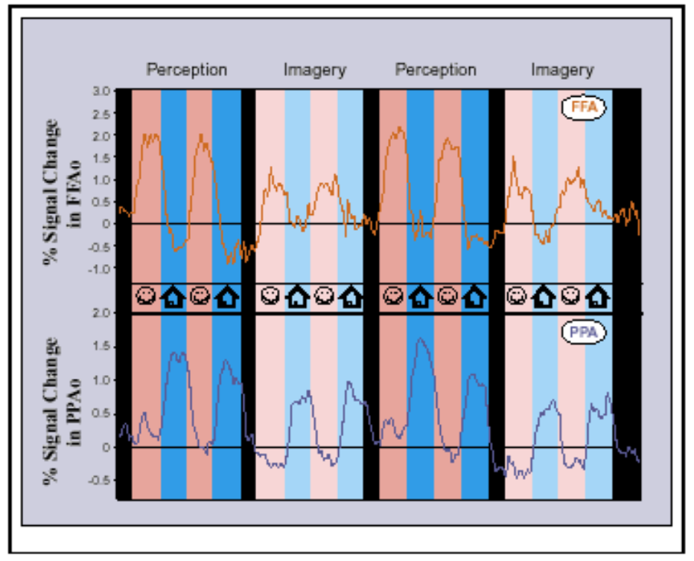
O’Craven & Kanwisher, 2000
DESIGN
Notes:
FACES – Fusiform Face Area
HOUSES – parahippocampal place area
This can be a “READOUT” for when people are paying attention to a particular type of info
we will harness that…

Slide 46
Behavioral Experiment
Learning
DESIGN

Slide 47
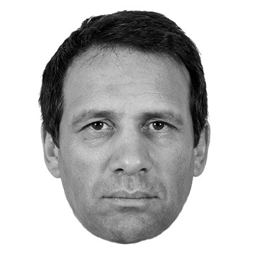
Behavioral Experiment
Learning
$1.00
DESIGN
Notes:
PAY attention to these faces as you will be tested on it after…

Slide 48
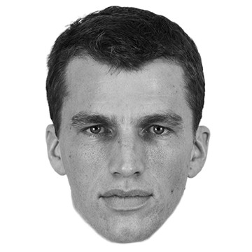
Behavioral Experiment
Learning
-$1.00
DESIGN

Slide 49
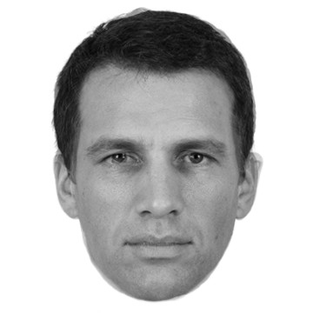
Behavioral Experiment
Learning
$0.00
DESIGN

Slide 50
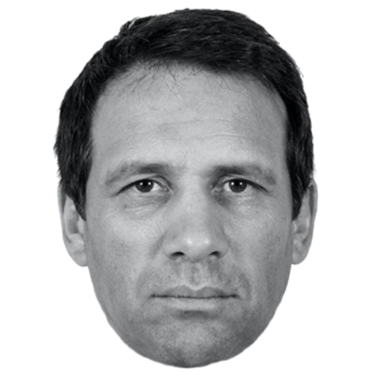
Behavioral Experiment
Learning
DESIGN

Slide 51
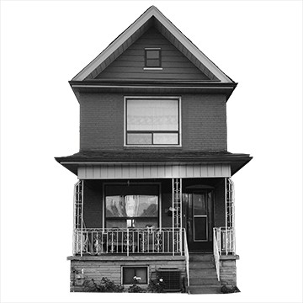
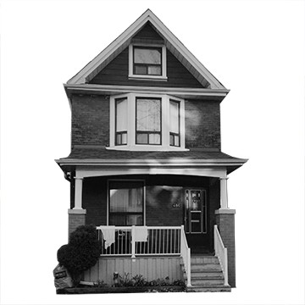
Behavioral Experiment
Learning
$1.00
-$1.00
DESIGN

Slide 52
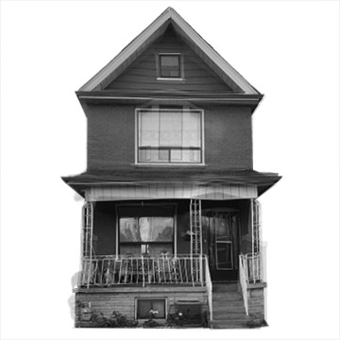
Behavioral Experiment
Learning
$0.50
DESIGN
Notes:
Behavioral
Learning (Testing)
Experiment/Choice
Fill out personality survey
risk aversion, loss aversion, working memory capacity

Slide 53
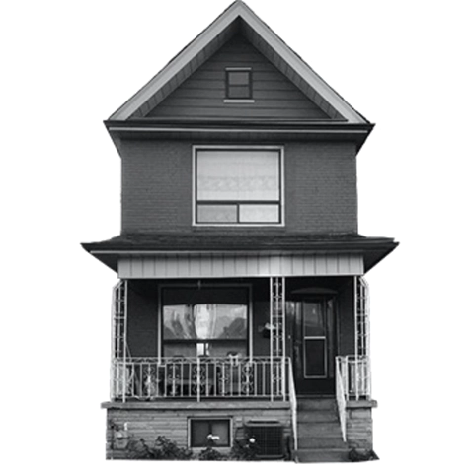
Behavioral Experiment
Learning
DESIGN
Notes:
Behavioral
Learning (Testing)
Experiment/Choice
Fill out personality survey
risk aversion, loss aversion, working memory capacity

Slide 54
Behavioral Experiment
Part 1
DESIGN
Notes:
In the experiment they will be shown two images – one of a face and one of a house.
Each will be associated with a certain value.
Based on the sum of values they can accept or reject.

Slide 55
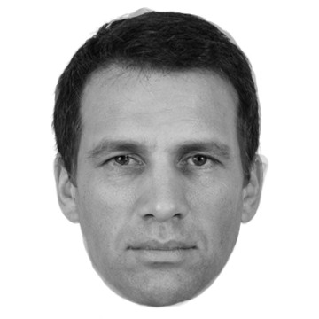
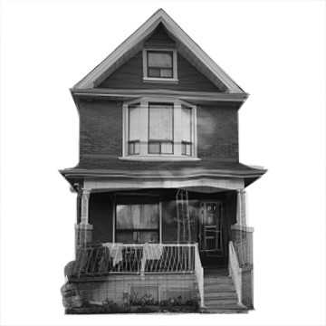
Behavioral Experiment
Part 1
Accept or Reject
DESIGN
Notes:
If the sum of the two values is positive, it would make sense to accept.
A correct acceptance wins them the corresponding sum of money.
An incorrect acceptance or rejection loses them the actual sum of the two values.
A correct rejection means your earnings remain the same.

Slide 56


Behavioral Experiment
Part 1
Accept Reject
$
0
-$
-$
DESIGN
Notes:
If the sum of the two values is positive, it would make sense to accept.
A correct acceptance wins them the corresponding sum of money.
An incorrect acceptance or rejection loses them the actual sum of the two values.
A correct rejection means your earnings remain the same.

Slide 57
Behavioral Experiment
Part 1
Accept or Reject
DESIGN
Notes:
If the sum of the two values is positive, it would make sense to accept.
A correct acceptance wins them the corresponding sum of money.
An incorrect acceptance or rejection loses them the actual sum of the two values.
A correct rejection means your earnings remain the same.

Slide 58
Behavioral Experiment
Part 1
$0.26
-$0.34
DESIGN
Notes:
Behavioral
Learning (Testing)
Experiment/Choice
Fill out personality survey
risk aversion, loss aversion, working memory capacity

Slide 59
Behavioral Experiment
Part 1
$0.26
-$0.34
-$0.08
Notes:
Correct Response: Reject
After completing a given number of these trials, Part 2

Slide 60
Behavioral Experiment
Part 1
Value = w₁*ValAttribute₁ + w₂*ValAttribute₂
DESIGN
Notes:
Part 1:
Equivalent scaling – you could think of it as ValAttribute = 0.75 x weighting of $1.

Slide 61
Behavioral Experiment
Part 1
Value = ValAttribute₁ + ValAttribute₂
DESIGN
Notes:
So Part 1 was essentially about VALUATIONS

Slide 62
Behavioral Experiment
Part 2
Value = w₁*ValAttribute₁ + w₂*ValAttribute₂ + ...
DESIGN
Notes:
Adding back in the ws
By means of a multiplier…

Slide 63
Behavioral Experiment
Part 2
3X
Accept or Reject
DESIGN
Notes:
Participants now must flexibly reassign their original weightings based on new information.
So if you recall the values for the face and the house, is this an offer you would accept or reject?

Slide 64
Behavioral Experiment
Part 2
3X
$0.26 x 3 = $0.78
-$0.34
DESIGN
Notes:
The new weighting effectively increases the total value of the face attribute.

Slide 65
Behavioral Experiment
Part 2
3X
$0.26 x 3 = $0.78
-$0.34
$0.44
Notes:
So now you would be correct to accept the combination.

Slide 66
Behavioral Experiment
Format
Part 1: 100 trials
Part 2: 200 trials
50% no multipliers
40% one multiplier
10% two multipliers
DESIGN
Notes:
Part 1
Purpose of unweighted block: reinforce a default value
Part 2
We have a learned default we have to move away from…how sticky is that default?
trials fully interleaved

Slide 67
Behavioral Experiment
Personality Survey
DESIGN
Notes:
risk aversion, loss aversion, working memory capacity

Slide 68
Behavioral Experiment
Expected Outcomes:
Difficult decisions take longer
DESIGN
Notes:
1. Assuming integrated values closer to zero are more difficult to decide on

Slide 69
Behavioral Experiment
Expected Outcomes:
Difficult decisions take longer
Re-weighting requires extra mechanisms
DESIGN
Notes:
2. That it is in some way more difficult -- this will be more directly addressed via imaging.

Slide 70
Imaging Experiment
fMRI & EEG
DESIGN
Notes:
Separate Trials
Spatial resolution
Temporal resolution
Participants will complete a short version of a standard face-house localizer task to identify subject-specific brain regions of interest in the fusiform face area and parahippocampal place area.
Multivariate analysis.

Slide 71
Experiment
analysis
1. Drift Diffusion Model Analysis
Affect of multipliers on attribute weighting
DESIGN
Notes:
1. FOR BOTH BEHAVIORAL AND IMAGING
DDM Analysis
Estimate from choices and reactions times the weight they are putting on houses and faces
Possible prediction - some people may not optimally reweight
May systematically under/overweight things
If you show slippage how does that relate to the personality/individuality questionnaires

Slide 72
Experiment
analysis
1. Drift Diffusion Model Analysis
Affect of multipliers on attribute weighting
2. Neural Representation of Value/Weight
modeled reweighting vs. brain region activation (vmPFC, FFA, PPA)
DESIGN
Notes:
Multivariate analysis to examine activation of brain regions
Now we can look at activation in the ROI (FFA/PPA)
Does activation in these areas go up based on VALUE/WEIGHTING?
How is Functional connectivity/communication between those areas and vmPFC affected?
vmPFC - how is it tracking value of faces/houses? Does it show increased connectivity with PPA/FFA on trials with higher values?
AND if we add a decision confidence response after each decision, how does this correlate with activity in vmPFC
Timing of multiplier appearance
What if you see the multiplier first?
How does communication between FFA vmPFC change before you see the face/house
To test the hypothesis that the attribute- encoding regions directly represent value or choice weights, I will look for evidence that 1) DDM decision weights for liquid and money correlate with average activation or parametric representation of attribute-values in FFA, PPA or gustatory cortex, and 2) DDM-estimated effects of multipliers correlate with differential increases in these regions during multiplier trials. To test the hypothesis that connections with vmPFC determine the weight received by an attribute, I will look for correlations between DDM weights and functional connectivity strength between the vmPFC and sensory areas. Finally, I will test whether both routes influence weights independently by entering them into a simultaneous regression to predict DDM-estimated decision weights on both normal and multiplier trials

Slide 73
Initial Questions
1. Where in the brain is attribute valuation happening?
2. Where in the brain is attribute weighting happening?
a. Cortical Areas
b. Ventromedial Prefrontal Cortex
c. Functional Pathways
d. ???
3. How do we re-weight attributes?
DESIGN
Notes:
Understanding 1 & 2 will allow us to get at #3
Which could shed light on subjects like self-control – where re-weighting is key

Slide 74
RESULTS

Slide 75
Behavioral Study
V1
RESULTS
Notes:
Understanding 1 & 2 will allow us to get at #3
Which could shed light on subjects like self-control – where re-weighting is key

Slide 76
V1 Numbers
40 (18 with questionnaires)
RESULTS
Notes:
Understanding 1 & 2 will allow us to get at #3
Which could shed light on subjects like self-control – where re-weighting is key

Slide 77
Behavioral Study
V2
RESULTS
Notes:
Understanding 1 & 2 will allow us to get at #3
Which could shed light on subjects like self-control – where re-weighting is key

Slide 78
V2 Numbers
45 with questionnaires
RESULTS
Notes:
Understanding 1 & 2 will allow us to get at #3
Which could shed light on subjects like self-control – where re-weighting is key

Slide 79
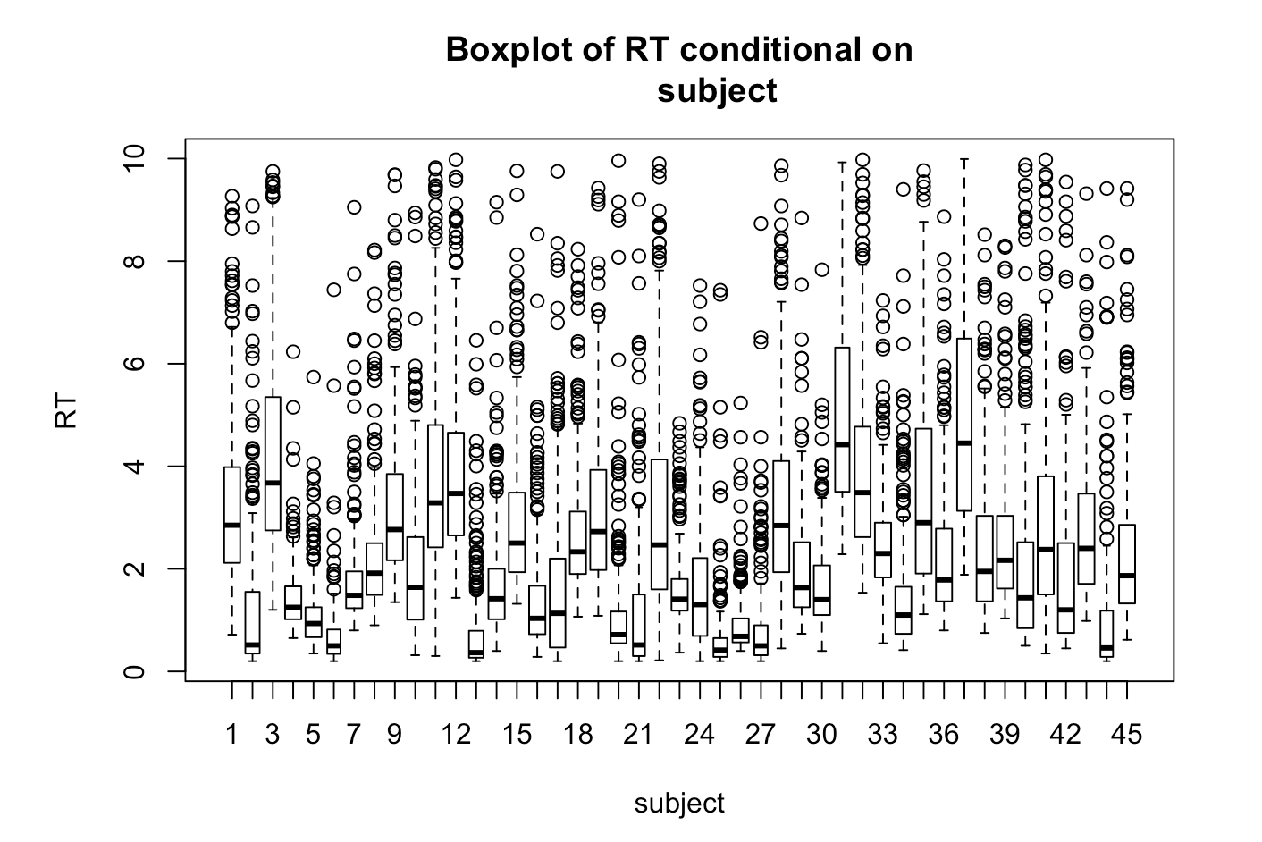
V2 Numbers
RESULTS
Notes:
Understanding 1 & 2 will allow us to get at #3
Which could shed light on subjects like self-control – where re-weighting is key

Slide 80
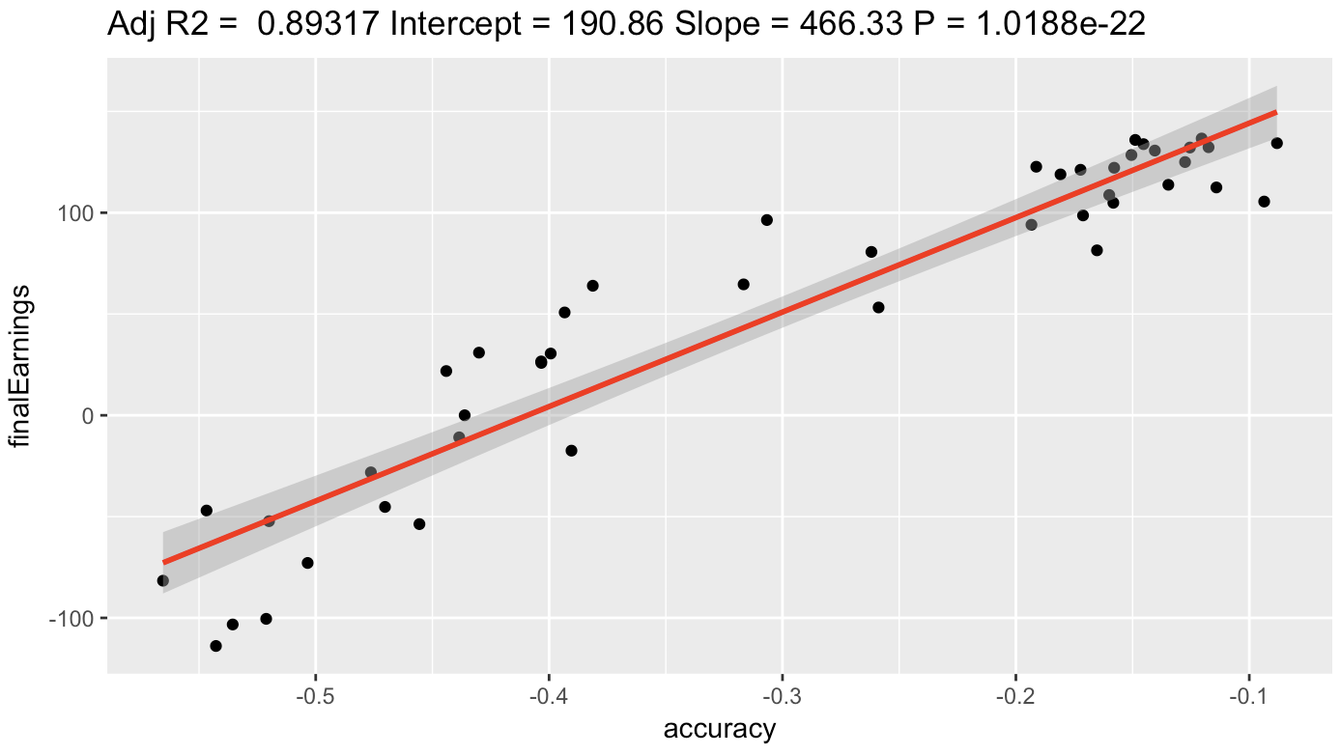
V2
Earnings v. Accuracy
RESULTS
Notes:
Understanding 1 & 2 will allow us to get at #3
Which could shed light on subjects like self-control – where re-weighting is key

Slide 81
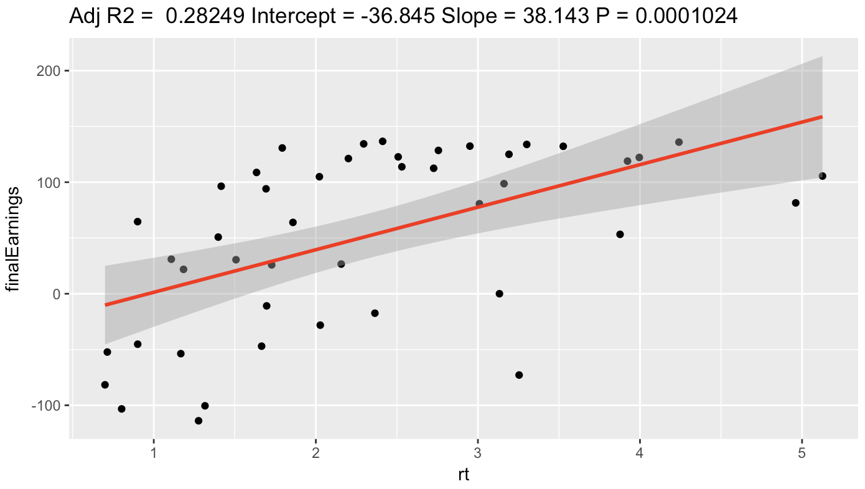
V2
Earnings v. Reaction Time
RESULTS
Notes:
Understanding 1 & 2 will allow us to get at #3
Which could shed light on subjects like self-control – where re-weighting is key

Slide 82
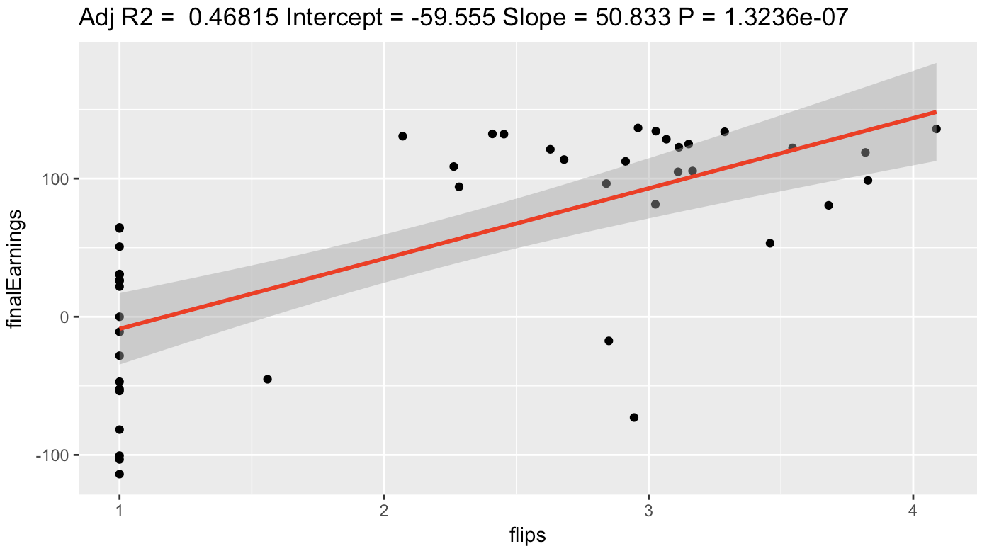
V2
Earnings v. Image Swaps
RESULTS
Notes:
Understanding 1 & 2 will allow us to get at #3
Which could shed light on subjects like self-control – where re-weighting is key

Slide 83
V2
EXPLAIN:
Selection of subjects (data cleaning)
RESULTS
Notes:
Understanding 1 & 2 will allow us to get at #3
Which could shed light on subjects like self-control – where re-weighting is key

Slide 84
V2
EXPLAIN:
Multiplier Effects
*1 multiplier faster than 0 or 2
RESULTS
Notes:
*is this true for 1 if it is difficult? What about same level of difficulty??!

Slide 85
V2
EXPLAIN:
Concept of flip trials
*mediocre results
RESULTS
Notes:
How can we be confident that we are separating the group correctly?

Slide 86
V2
EXPLAIN:
Modeling (lme)
Mult are significant (but only insofar as tied to value?)
RESULTS
Notes:
How can we be confident that we are separating the group correctly?

Slide 87
V2
EXPLAIN:
Questionnaires
No real effects
RESULTS
Notes:
What about for difference between people who did poorly and well?
Could do the 1 v 1 comparison like for correct/incorrect responses?

Slide 88
V2
EXPLAIN:
Stroop
No significant results
RESULTS
Notes:
How can we be confident that we are separating the group correctly?

Slide 89
NEXT
STEPS

Slide 90
fMRI: ANALYSIS
NEXT STEPS
Notes:
Eye tracking/ VR
Find out what is being attended to and when

Slide 91
Parametric Modulation Design
Manipulate/measure variables parametrically within-person
Can provide stronger evidence than contrasts for brain-task/brain-performance relationships
*Eye tracking?
NEXT STEPS
Notes:
Eye tracking/ VR
Find out what is being attended to and when

Slide 92
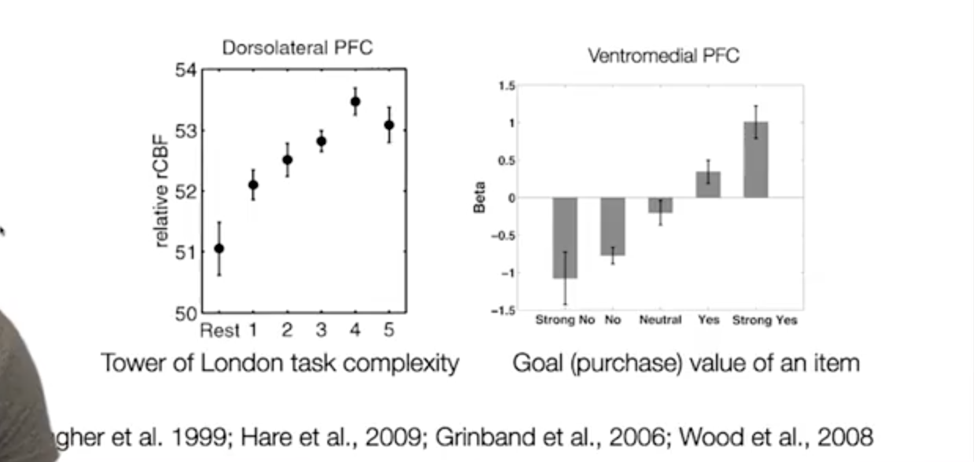
NEXT STEPS
Notes:
Eye tracking/ VR
Find out what is being attended to and when

Slide 93
Potential Between Person Variables of Interest
Cognitive Abilities
- as measured by Stroop/GoNoGo/n-Back
Age
Personality Characteristics
Group Identity
NEXT STEPS
Notes:
Eye tracking/ VR
Find out what is being attended to and when

Slide 94
fMRI: ANALYSIS
NEXT STEPS
Notes:
Eye tracking/ VR
Find out what is being attended to and when

Slide 95
FUTURE
DIRECTIONS

Slide 96
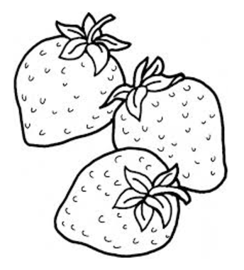
FUTURE DIRECTIONS
Notes:
Eye tracking/ VR
Find out what is being attended to and when

Slide 97

FUTURE DIRECTIONS
Notes:
Eye tracking/ VR
Find out what is being attended to and when

Slide 98

FUTURE DIRECTIONS
Notes:
Eye tracking/ VR
Find out what is being attended to and when

Slide 99
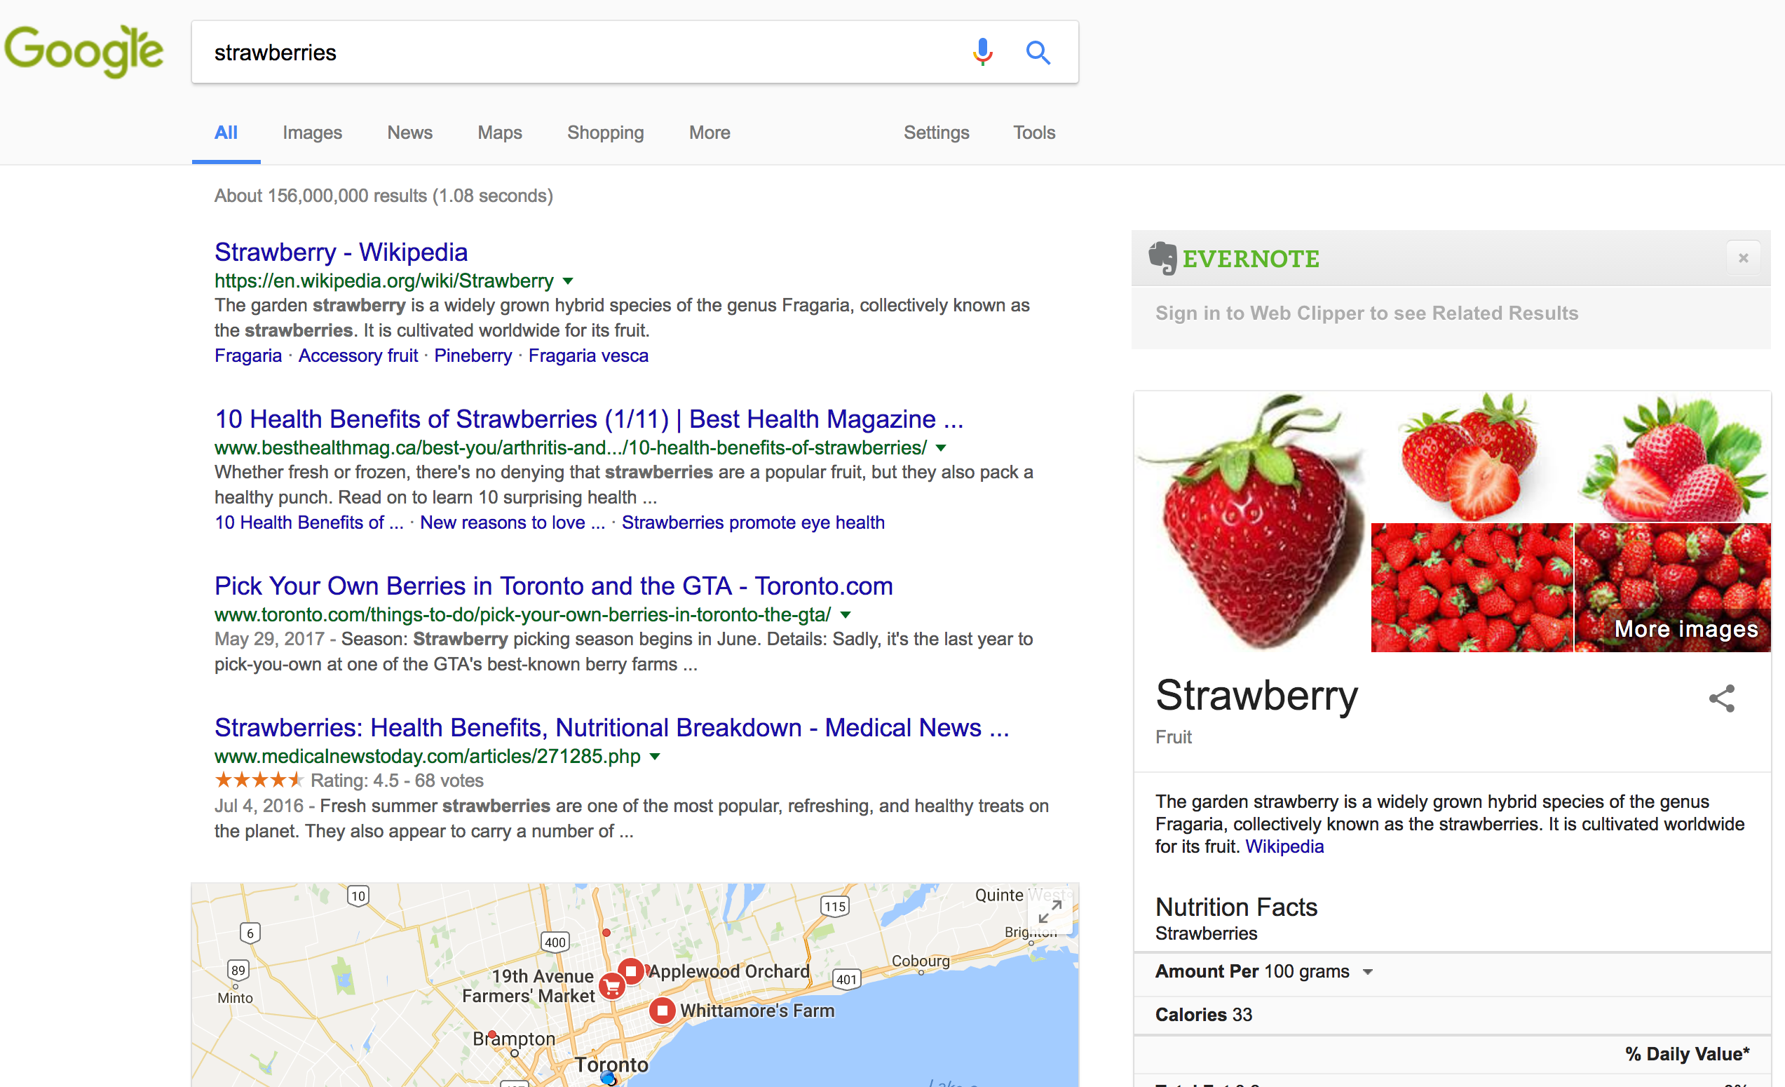
FUTURE DIRECTIONS
Notes:
Eye tracking/ VR
Find out what is being attended to and when

Slide 100
Eye Tracking/Virtual Reality
FUTURE DIRECTIONS
Notes:
Eye tracking/ VR
Find out what is being attended to and when

Slide 101
Eye Tracking/VR
Risk Aversion
FUTURE DIRECTIONS
Notes:
If we ran a version where a PASS didn’t lose money for being wrong (NO CONSEQUENCES FOR BEING CAUTIOUS), at what value do people start “ACCEPTING”…
And how does that connect to personality survey?

Slide 102
Eye Tracking/VR
Risk Aversion
Correlate Risk & Difficulty
FUTURE DIRECTIONS
Notes:
As described the hardest decisions have the lowest consequences.
What if you reverse that?
Can attention attenuate noise?

Slide 103
Eye Tracking/VR
Risk Aversion
Correlate Risk & Difficulty
Reweighting Bias
FUTURE DIRECTIONS
Notes:
Are there ways to improve or impair our reweighting?
And how does the nature of the attribute affect our ability to reweight?
High level: Identity-related attributes
Low level: Pain or taste
SELF CONTROL

Slide 104
Eye Tracking/VR
Risk Aversion
Correlate Risk & Difficulty
Reweighting Bias
Multiple Options
FUTURE DIRECTIONS
Notes:
What if we are looking at multiple multi-attribute options
Can we find the neural correlates of feedback loops?

Slide 105
The Neural Mechanisms
of Attribute Weighting
in Choice Valuation
Thanks to:
Cendri Hutcherson
Contact: daniel.j.wilson@gmail.com

Slide 107
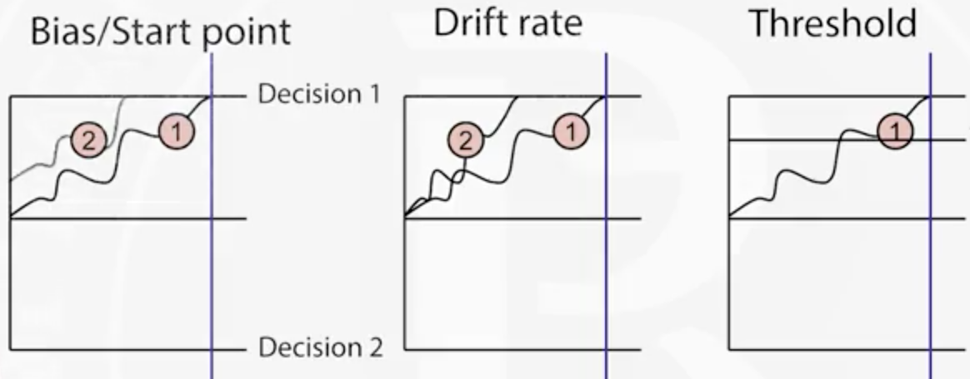
Notes:
Multi-alternative decision field theory
Townsend, Busemeyer (multi-attribute choice) (or row and busemeyer)
decision field theory 2001, 1993
Which attribute are people attending to and when?
You can decode whether someone is thinking about/attending to a house vs face
Do you see both representation active at the same time? Or sequential?
fMRI
Based on todd hare we think there are areas that are important but we don’t really know what they are doing…
Talk about self-control aspect – shifting those weights?

Slide 108
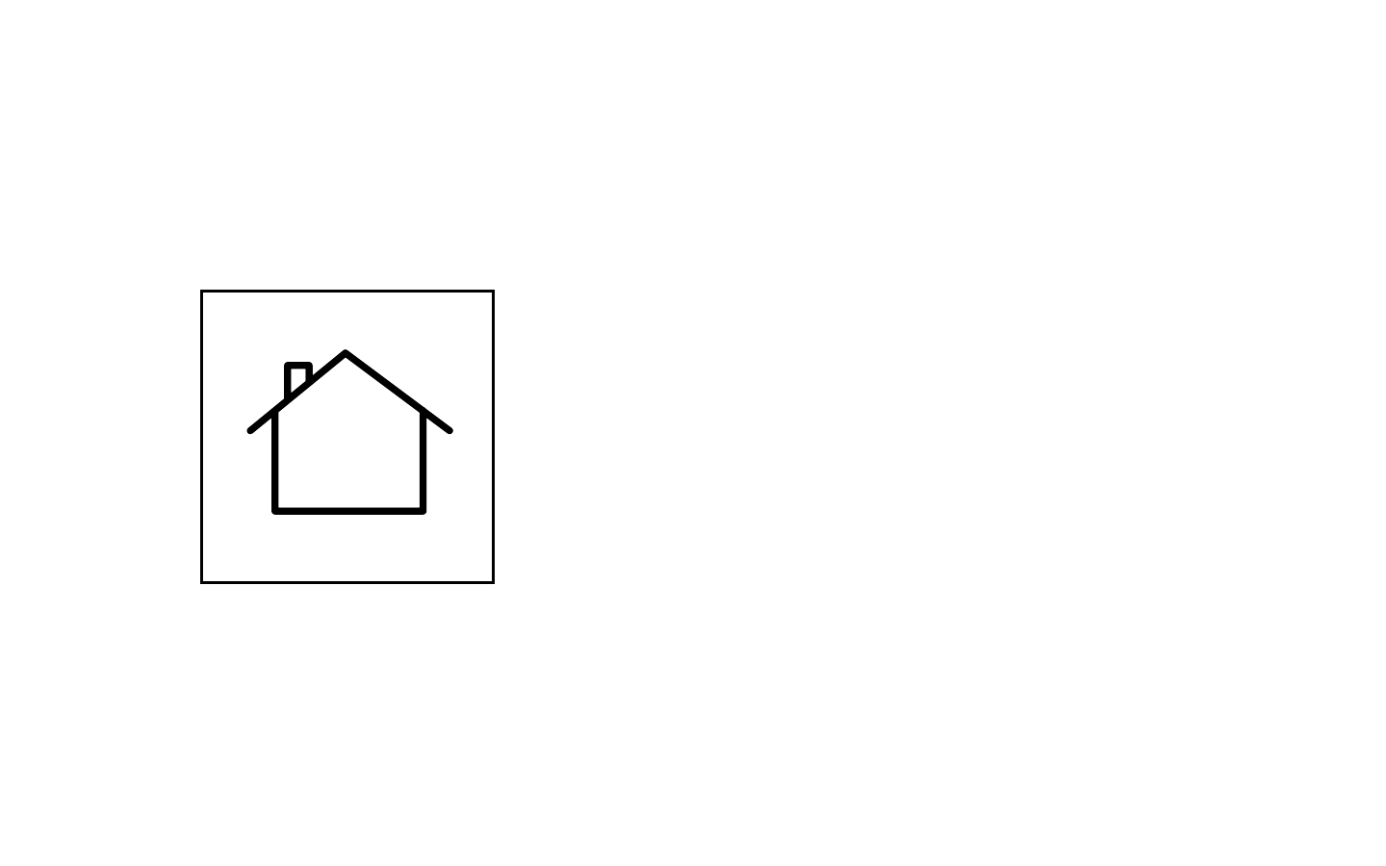
BACKGROUND
Notes:
So lets schematize this multi-attribute choice of a home purchase.

Slide 109
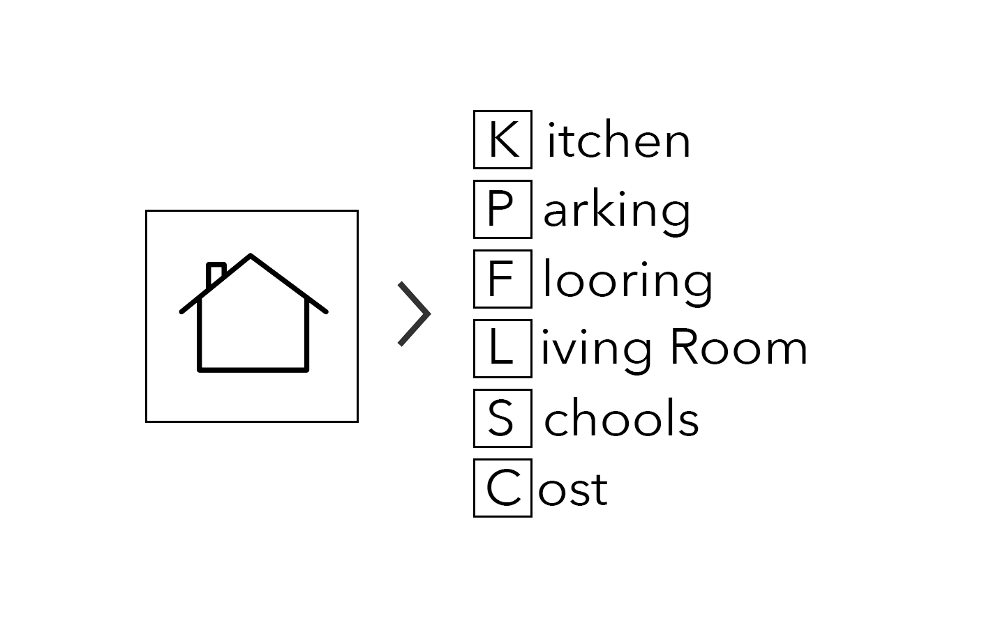
BACKGROUND
Notes:
We’ll drastically reduce things to 4 attributes.
All that we care about is:

Slide 110
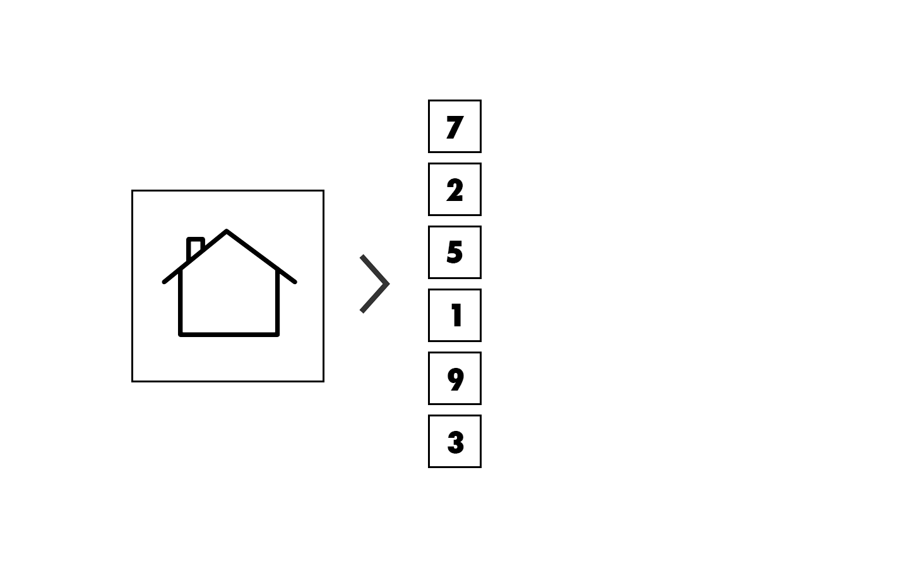
BACKGROUND
Notes:
Assign attributes values

Slide 111
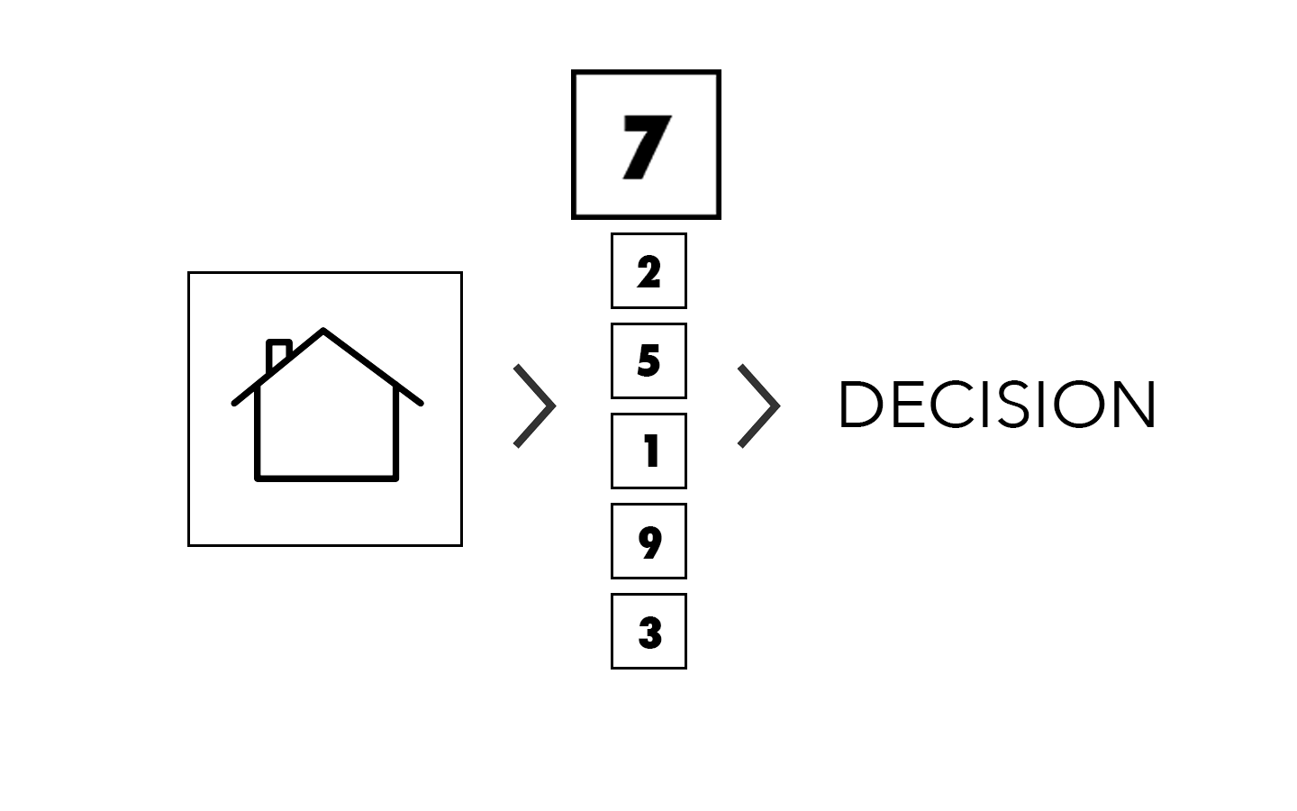
BACKGROUND
Notes:
Values have weights

Slide 112
BACKGROUND
Notes:
Standard models of choice in psychology and economics assume that the overall value of an option is constructed using a weighted sum of the relevant attributes

